Slide 1


Slide 2
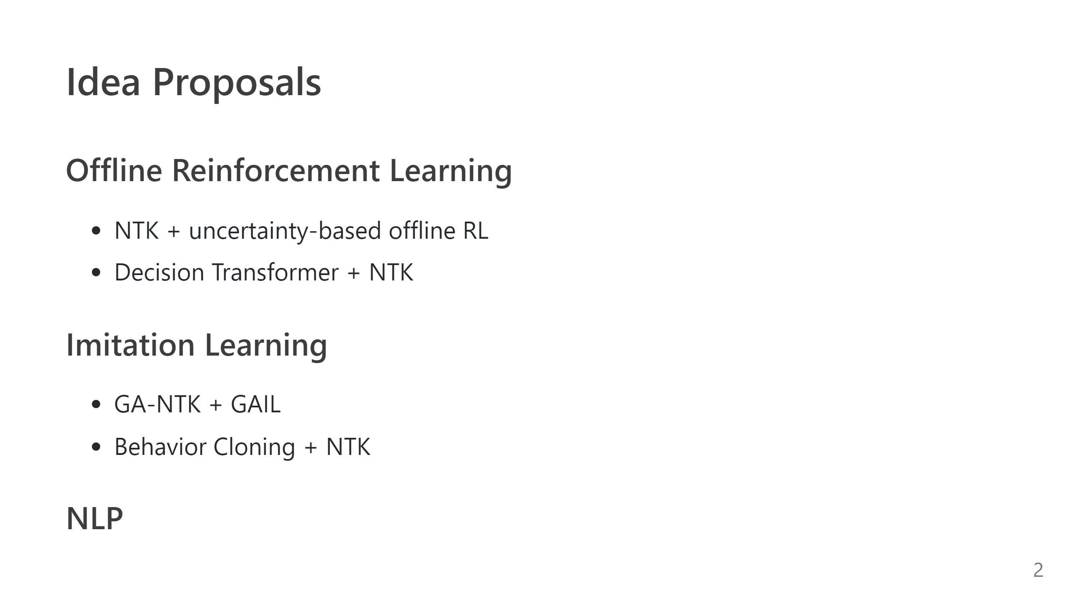
Notes:
- NTK + policy-constrained offline RL

Slide 3
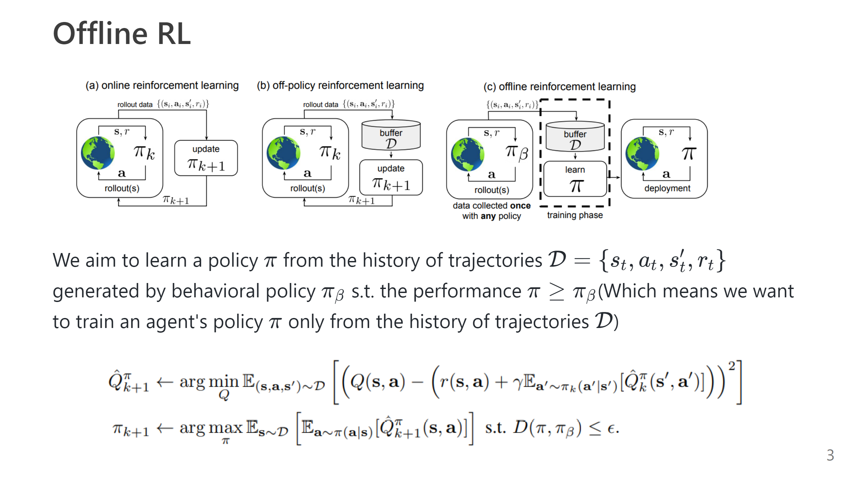

Slide 4
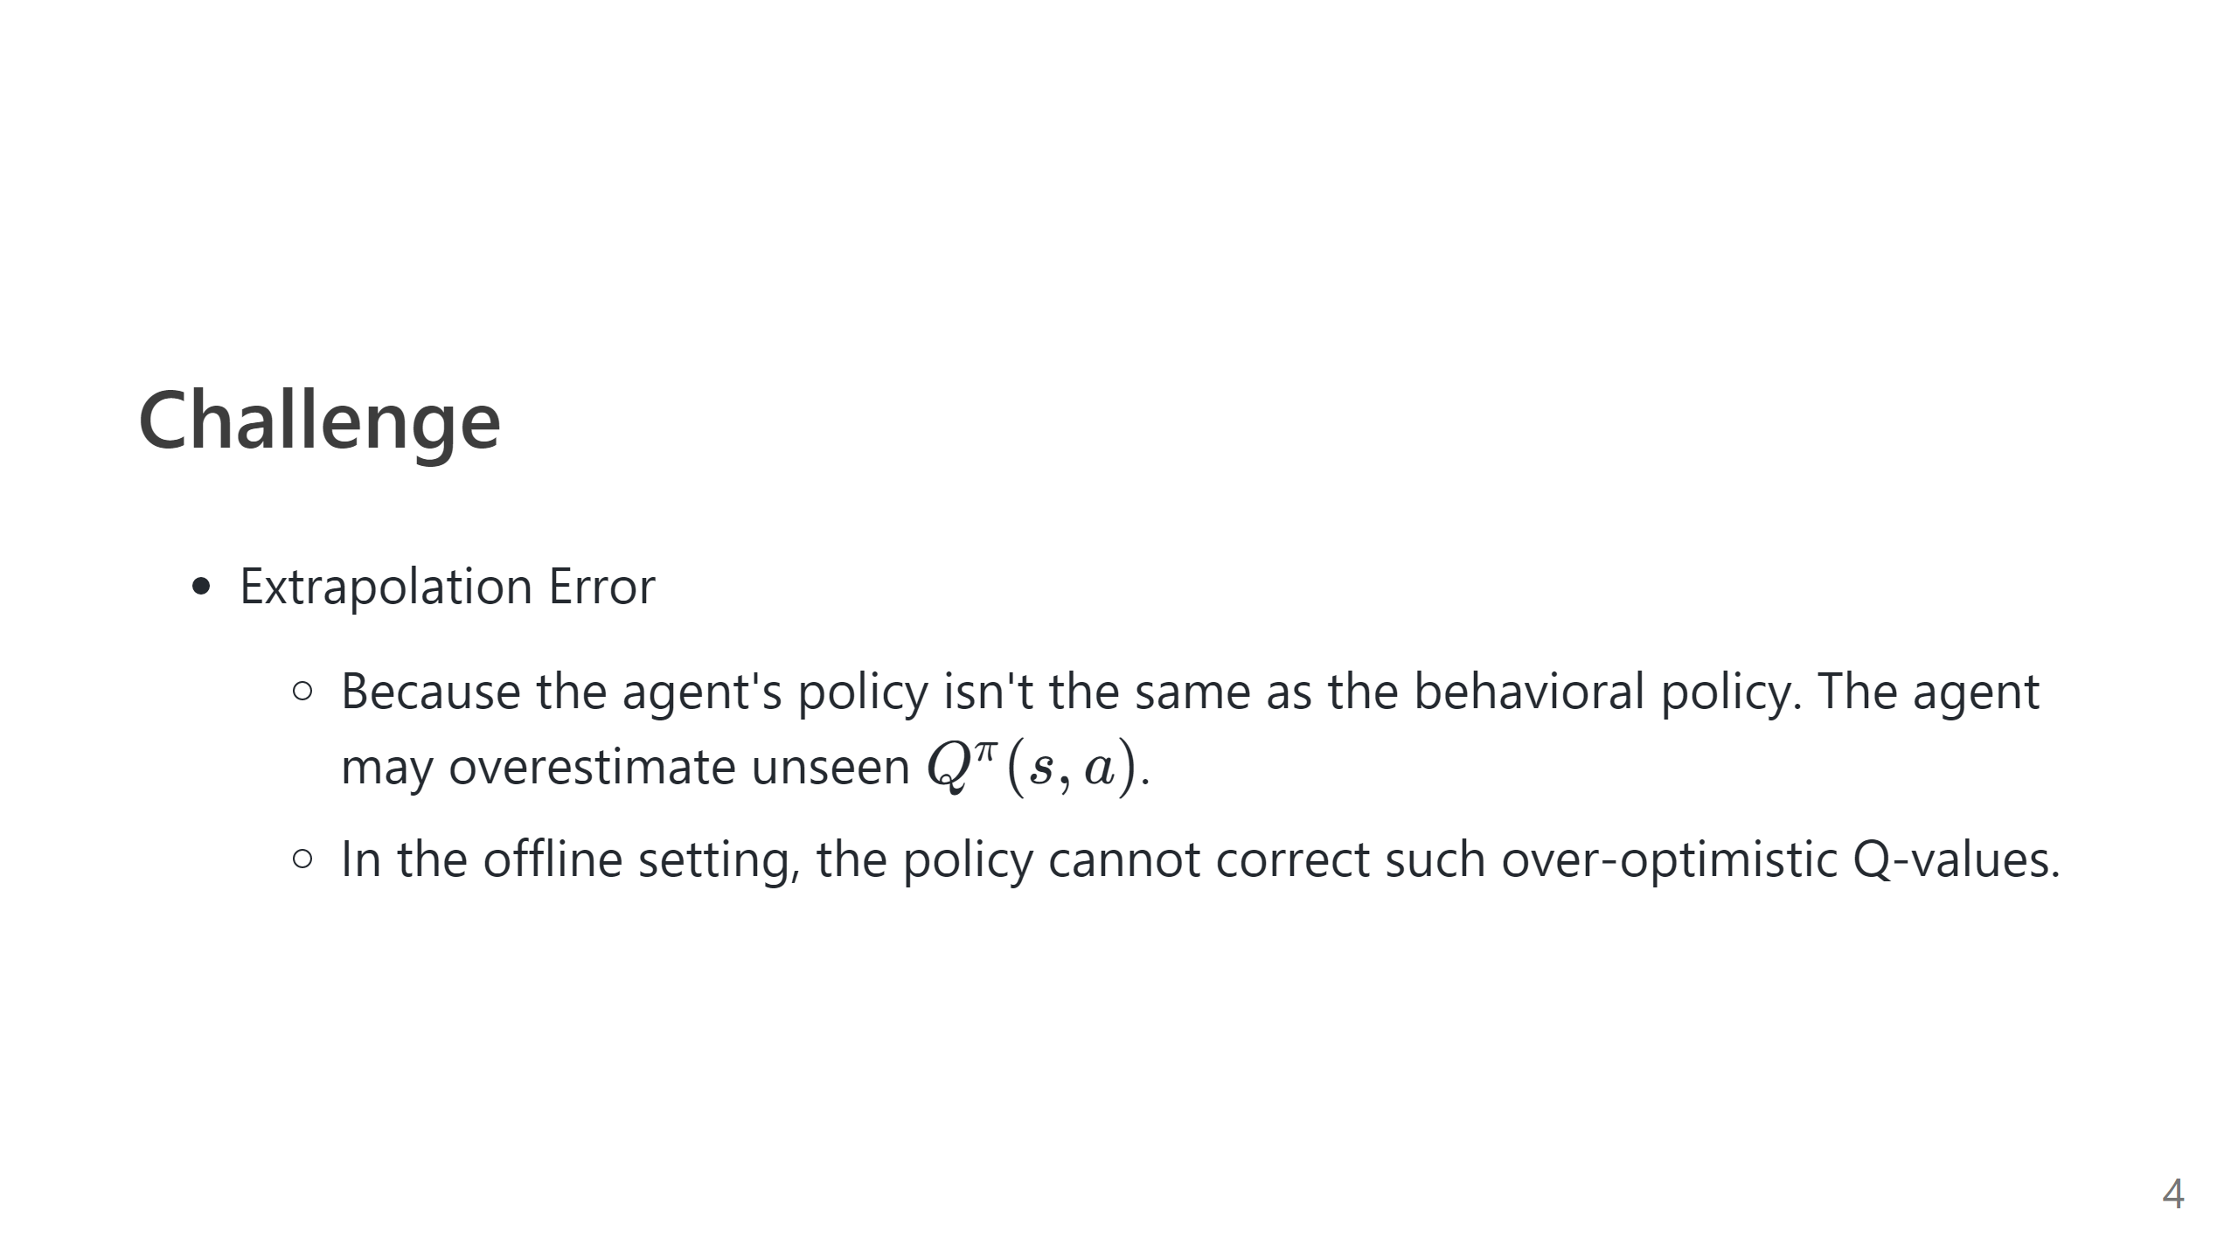

Slide 5
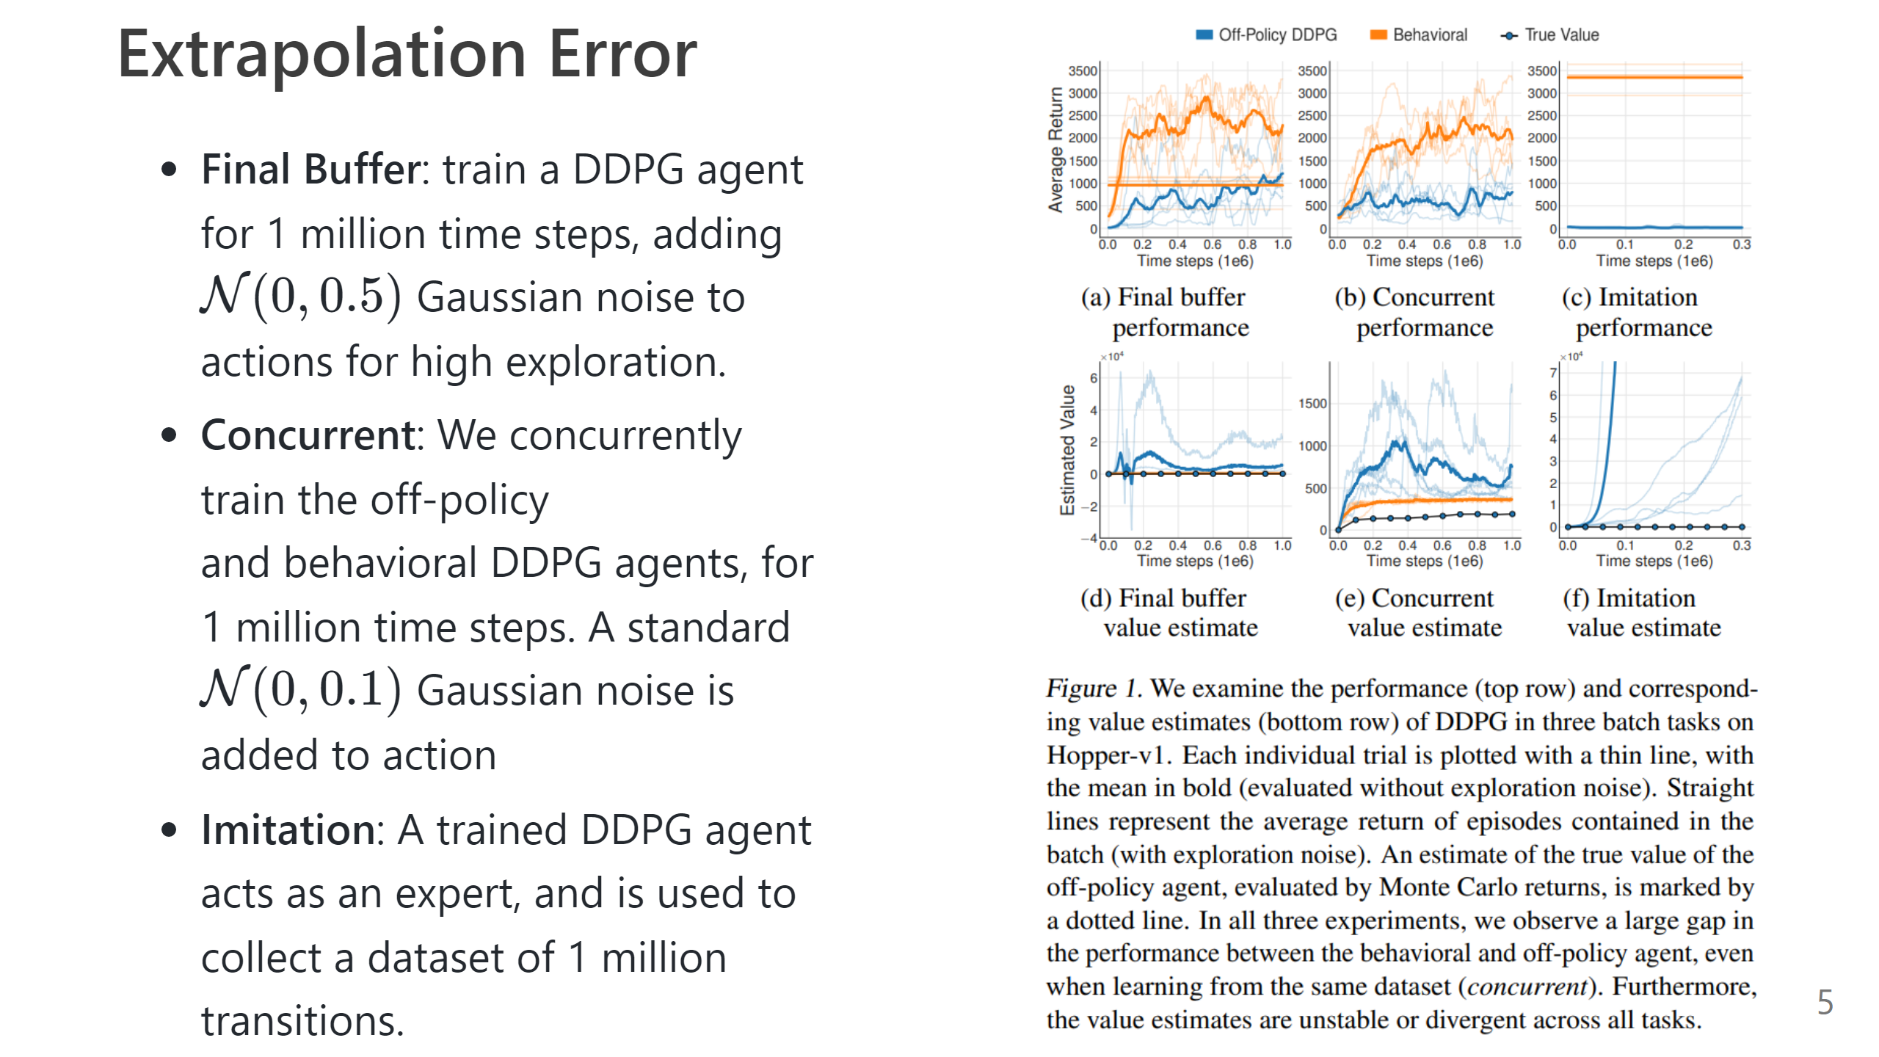

Slide 6
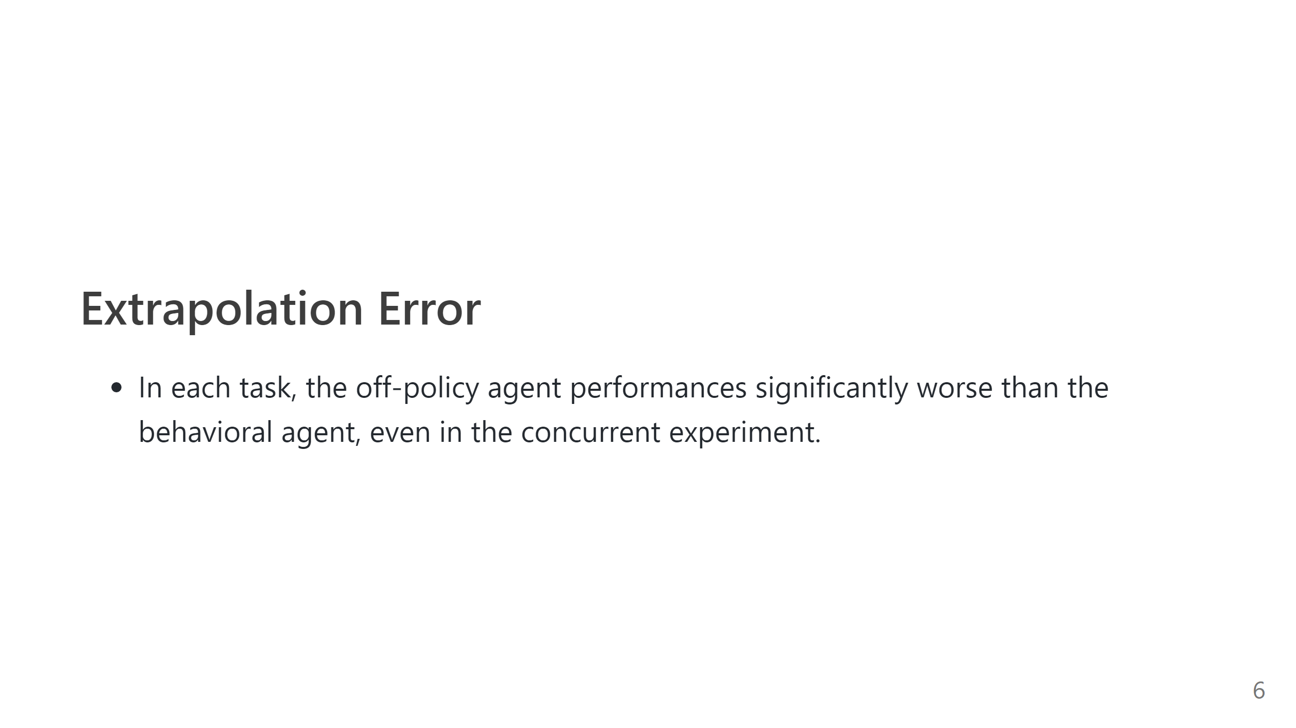

Slide 7
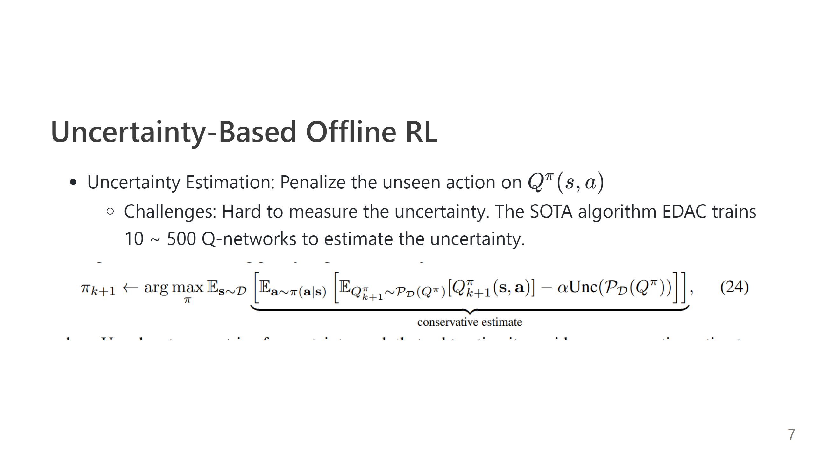
Notes:
# Solutions for Extrapolation Error - Support Constraints: Penalizes the total amount of probability mass on out-of-distribution actions under the $\pi$ distribution $$ D_{support, \epsilon}(\pi(\cdot | s), \pi_{\beta}(\cdot | s)) = \sum_{a \in \mathcal{A}, \pi_{\beta}(a | s) \leq \epsilon} \pi(a | s) $$ - MMD distance does not depend on the specific densities of the behavior distribution or the policy, and can be computed via a kernel-based distance on samples from each distribution - However, MMD just provides sufficient enough for constraining supports when finite samples are used. - SOTA algorithm: BEAR --- # Policy Constraints Offline RL ![](img/offline_rl_ipm.png) Distance measured in MMD ![](img/offline_rl_mmd.png) --- # IDEA 1: NTK instead of MMD ---

Slide 8
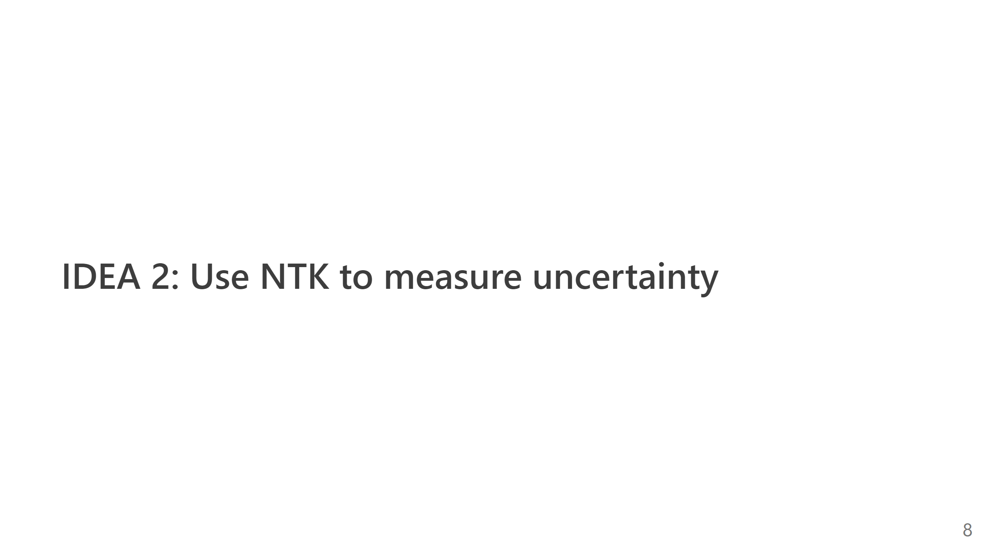

Slide 9
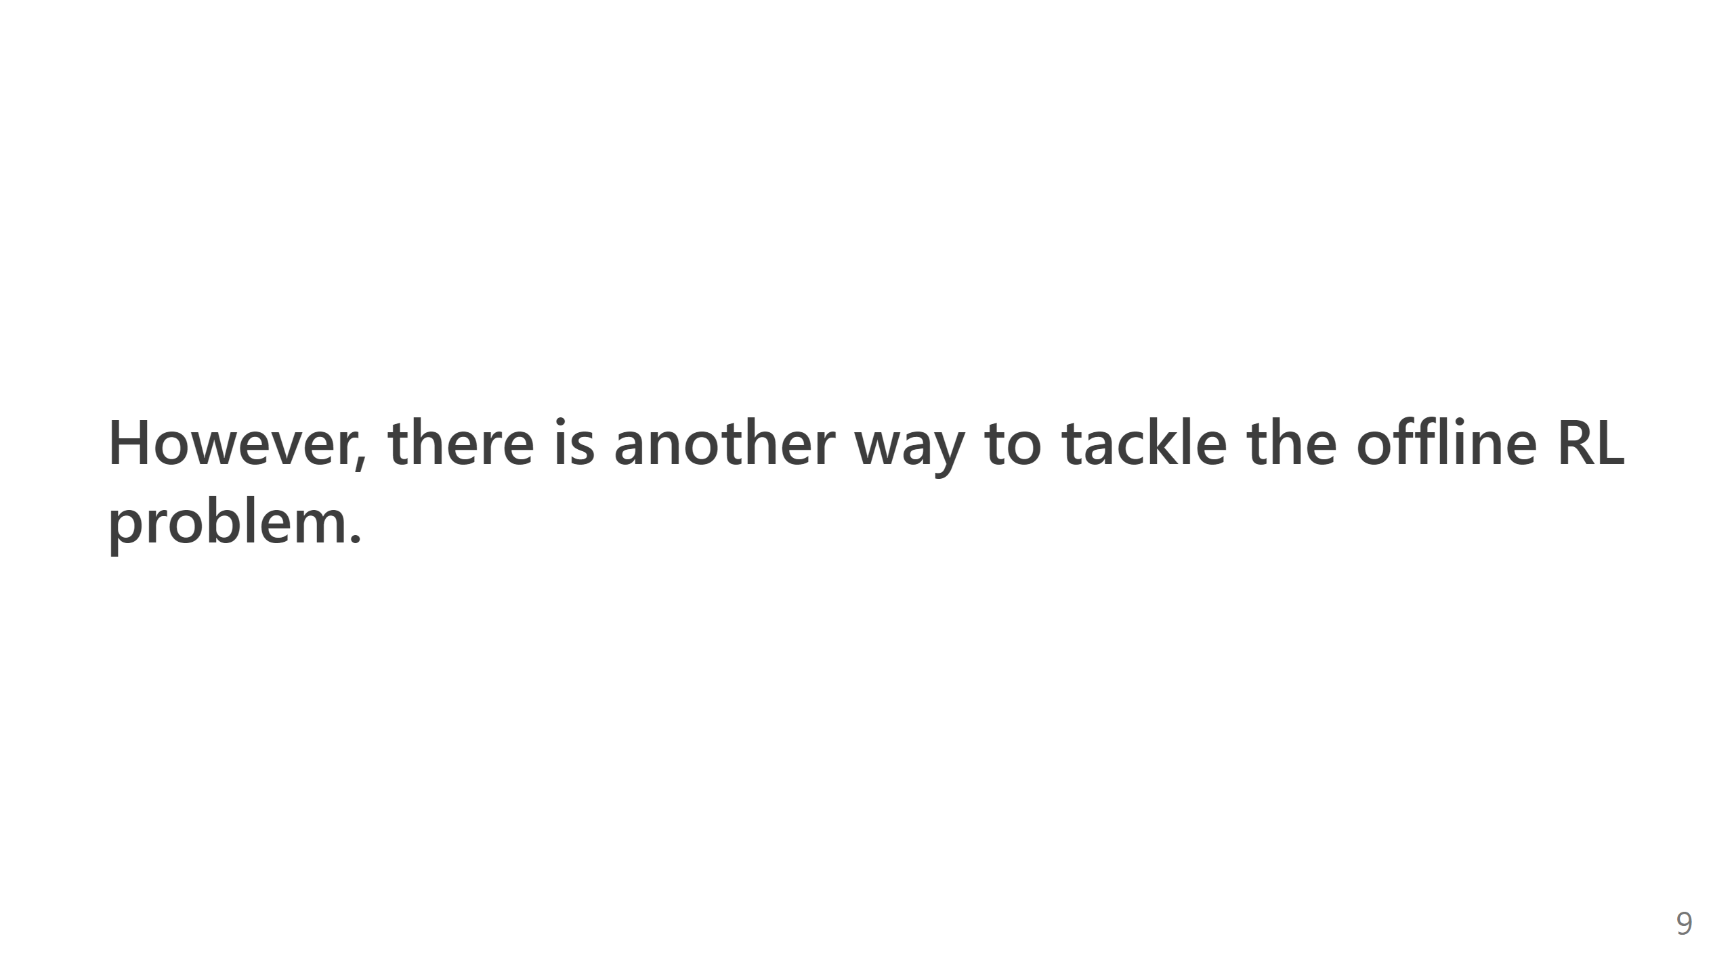

Slide 10
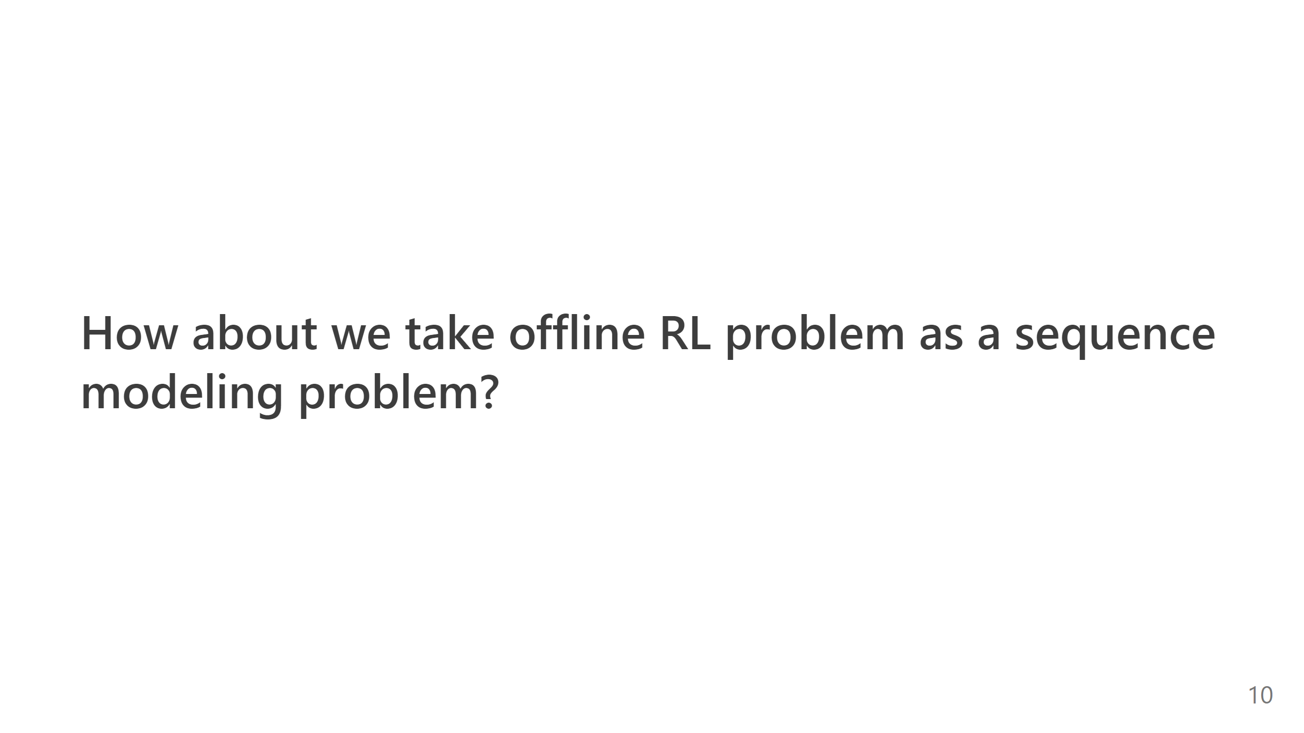

Slide 11
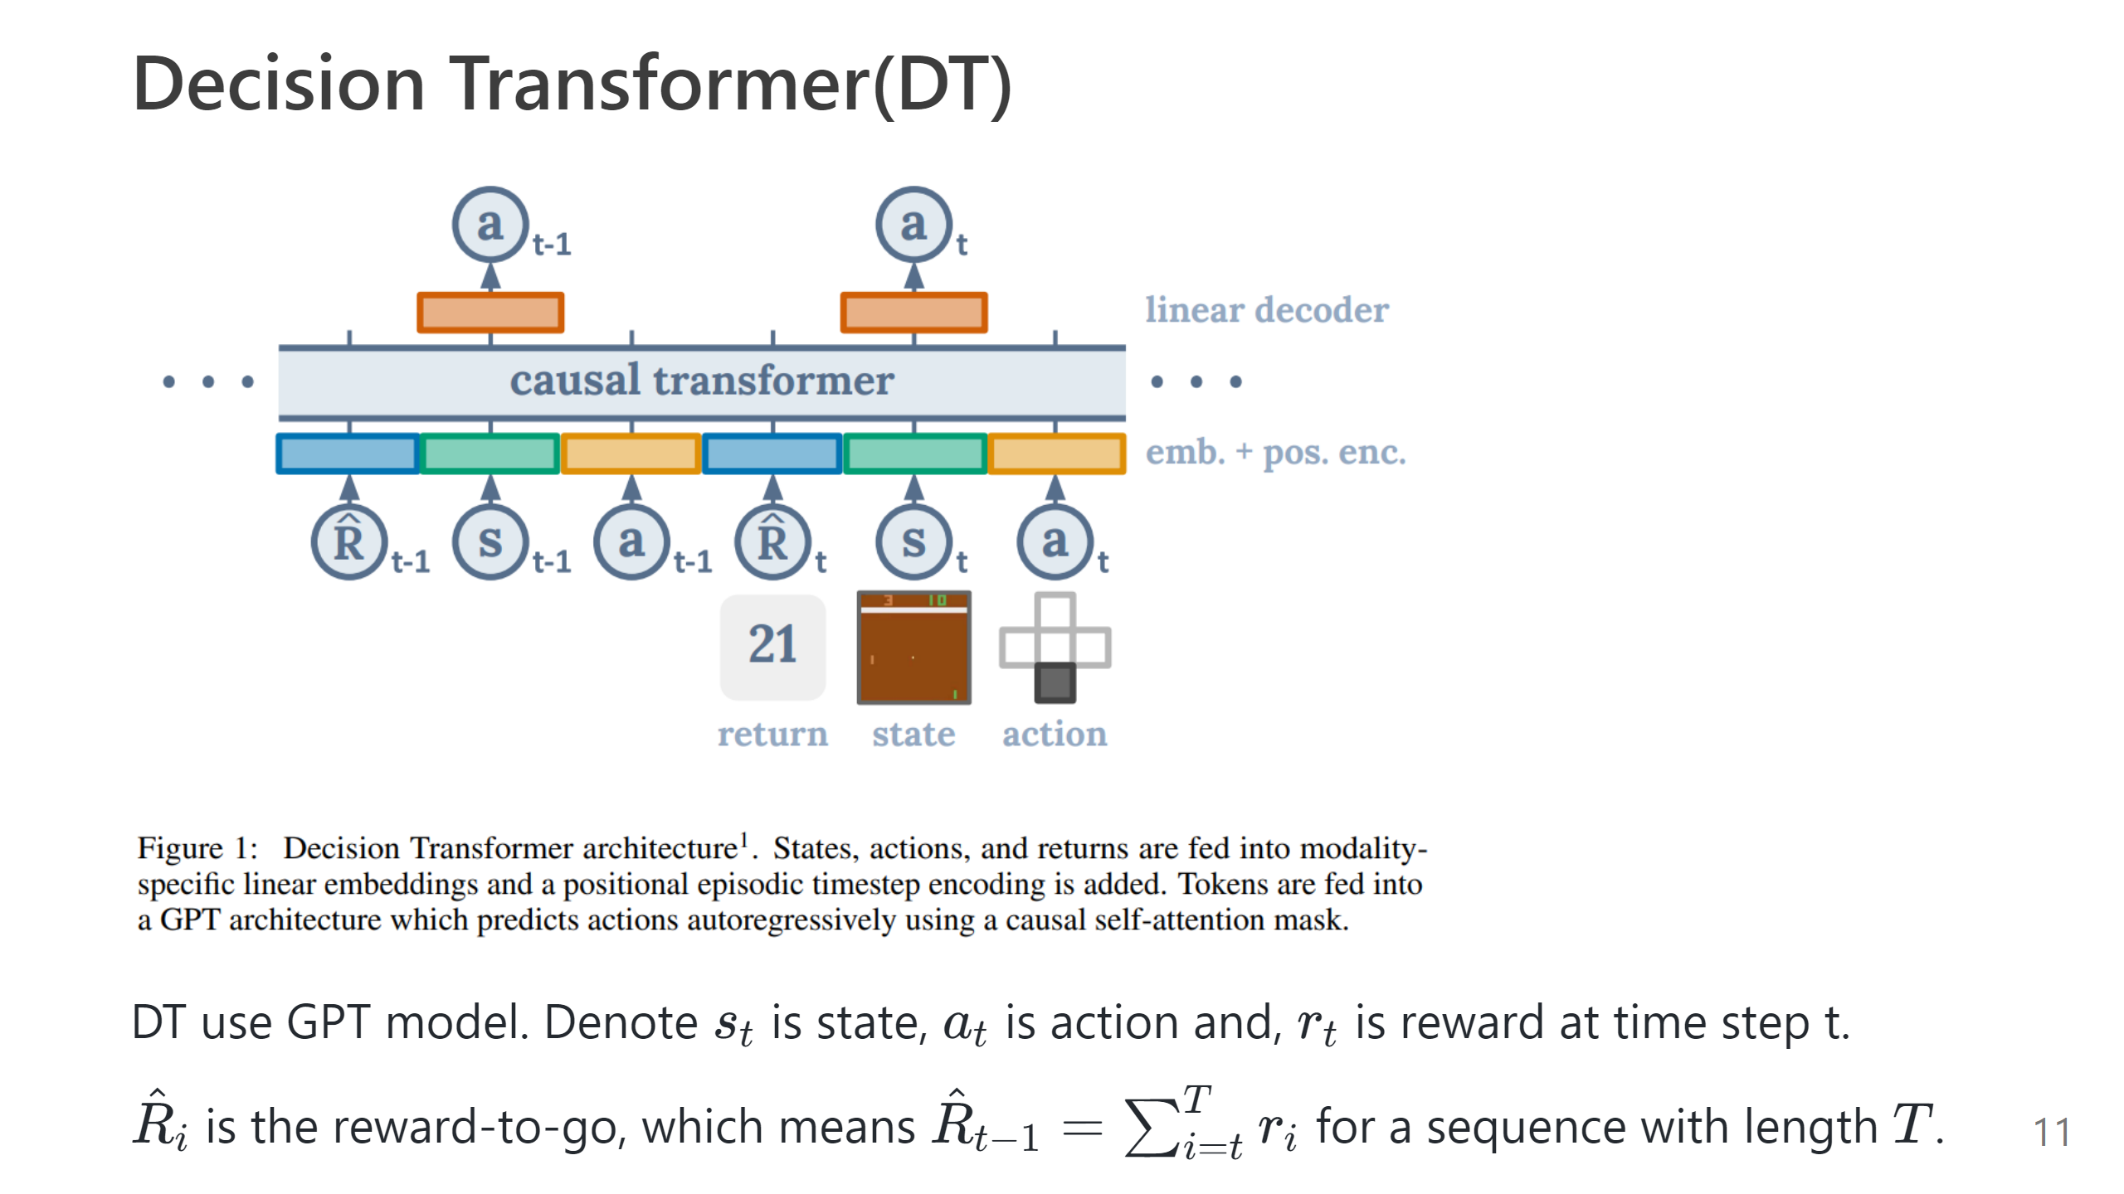

Slide 12


Slide 13
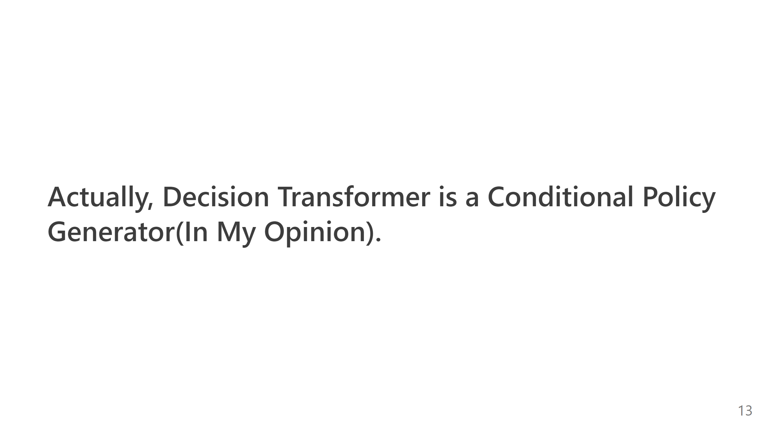

Slide 14
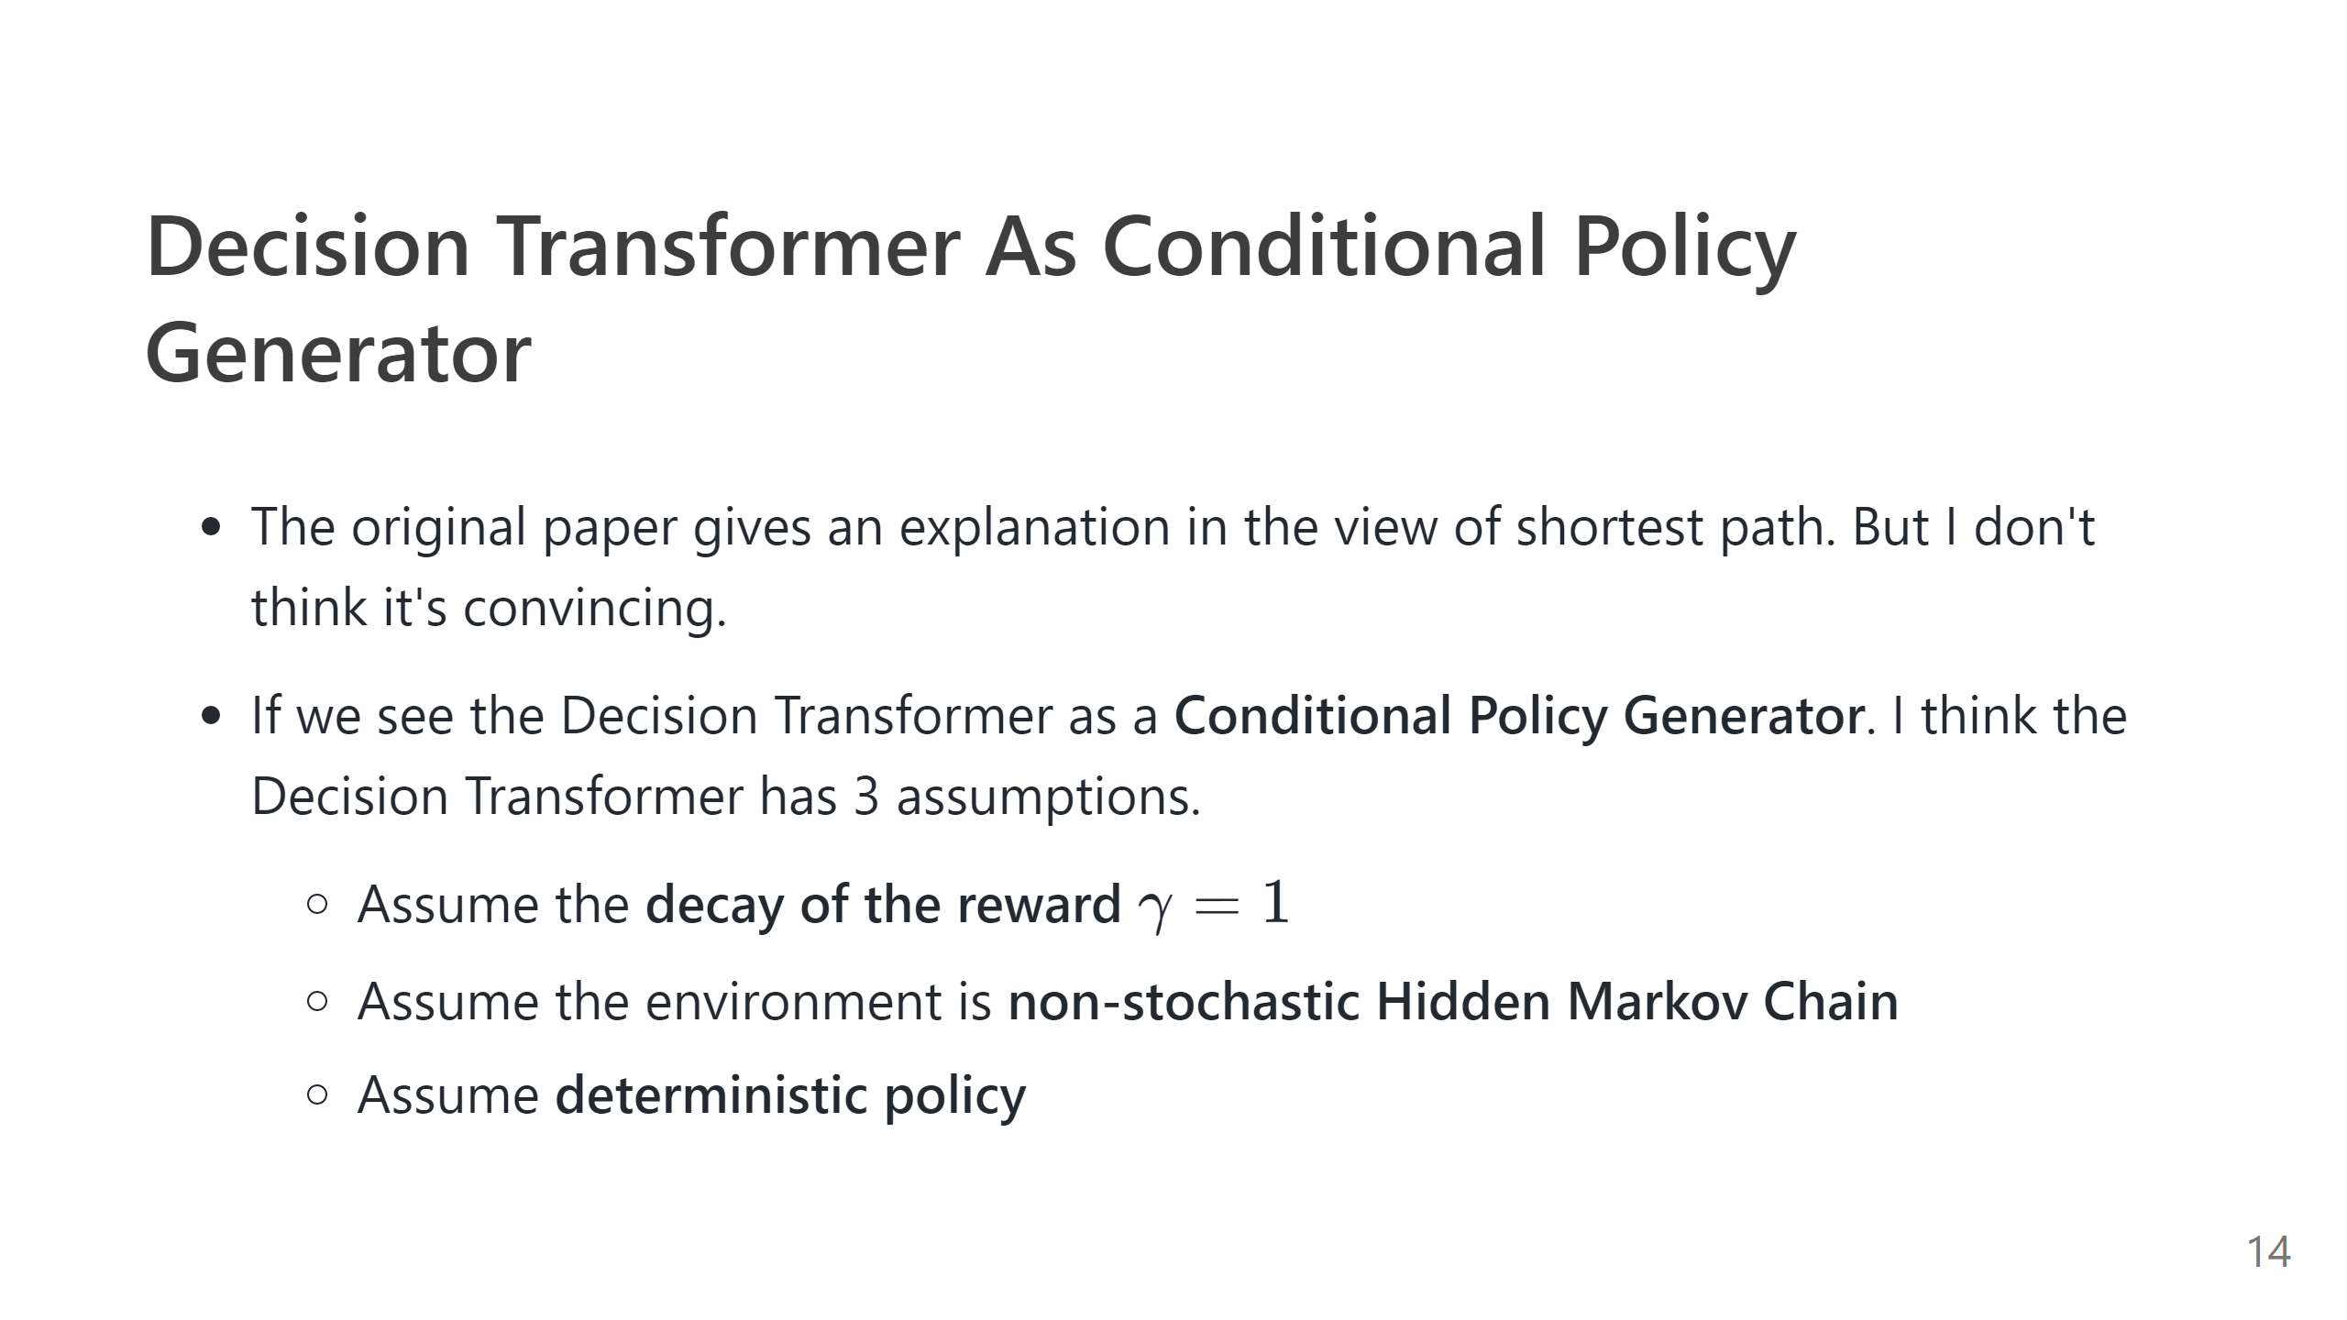

Slide 15
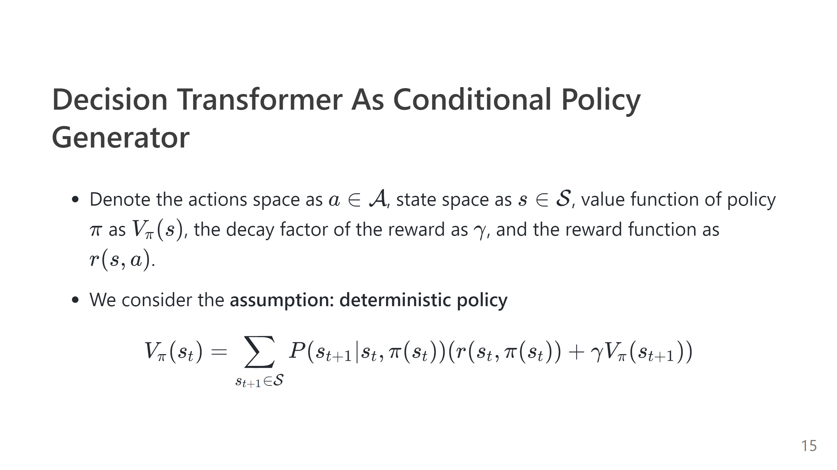

Slide 16
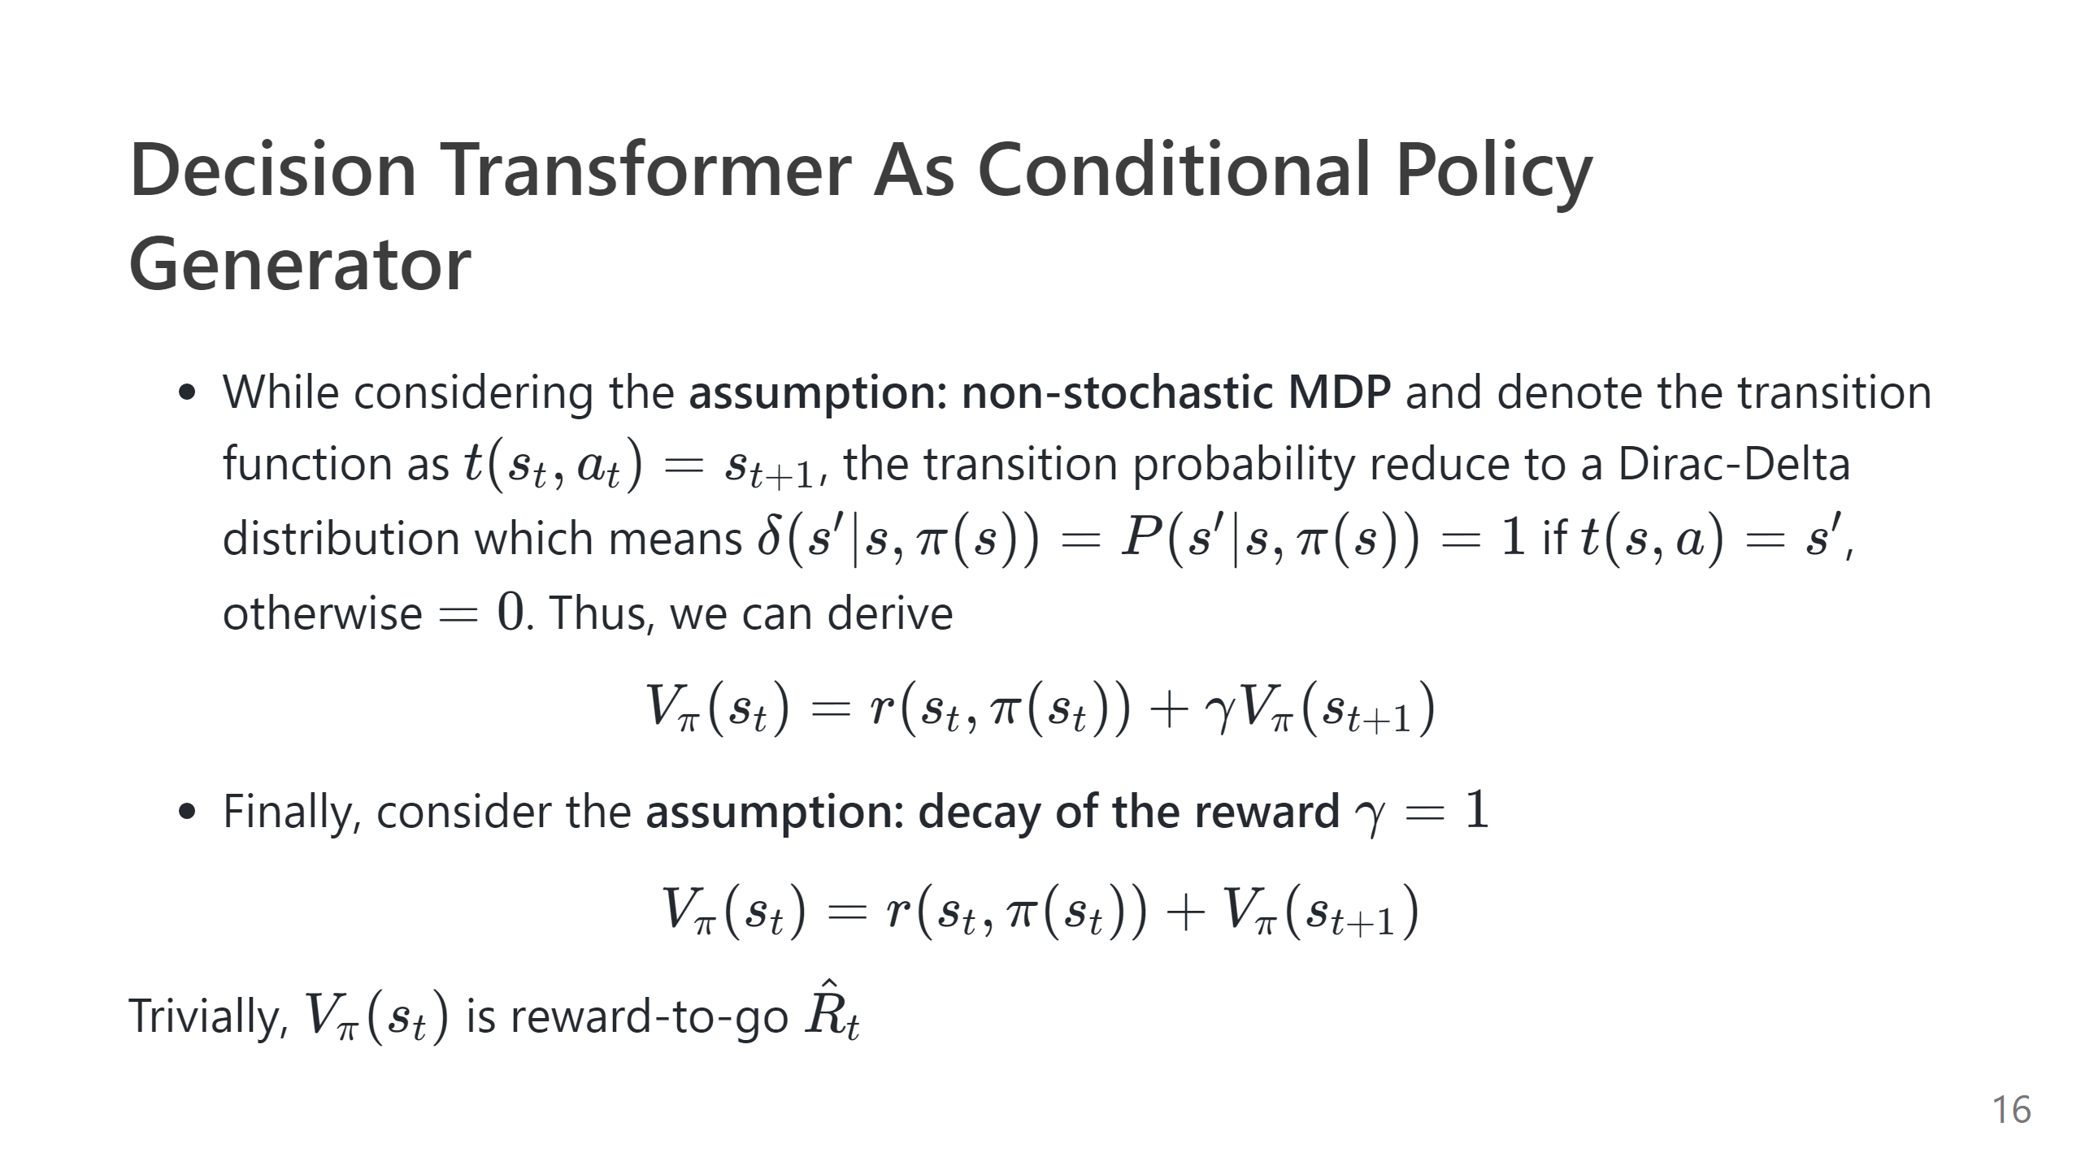

Slide 17
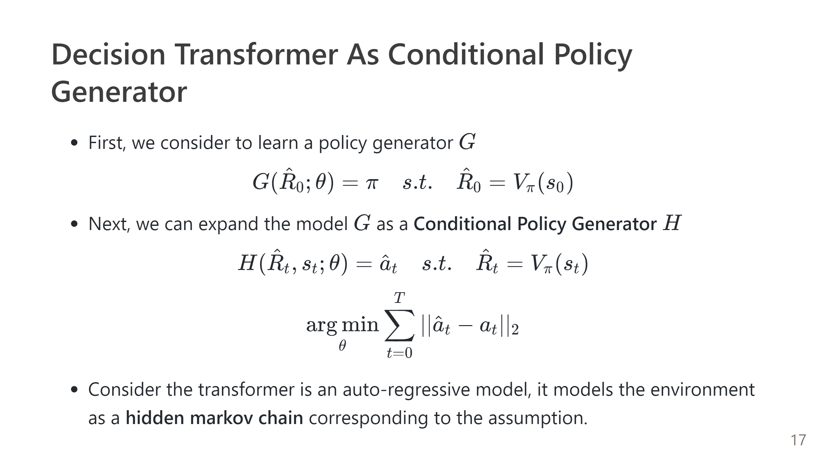

Slide 18
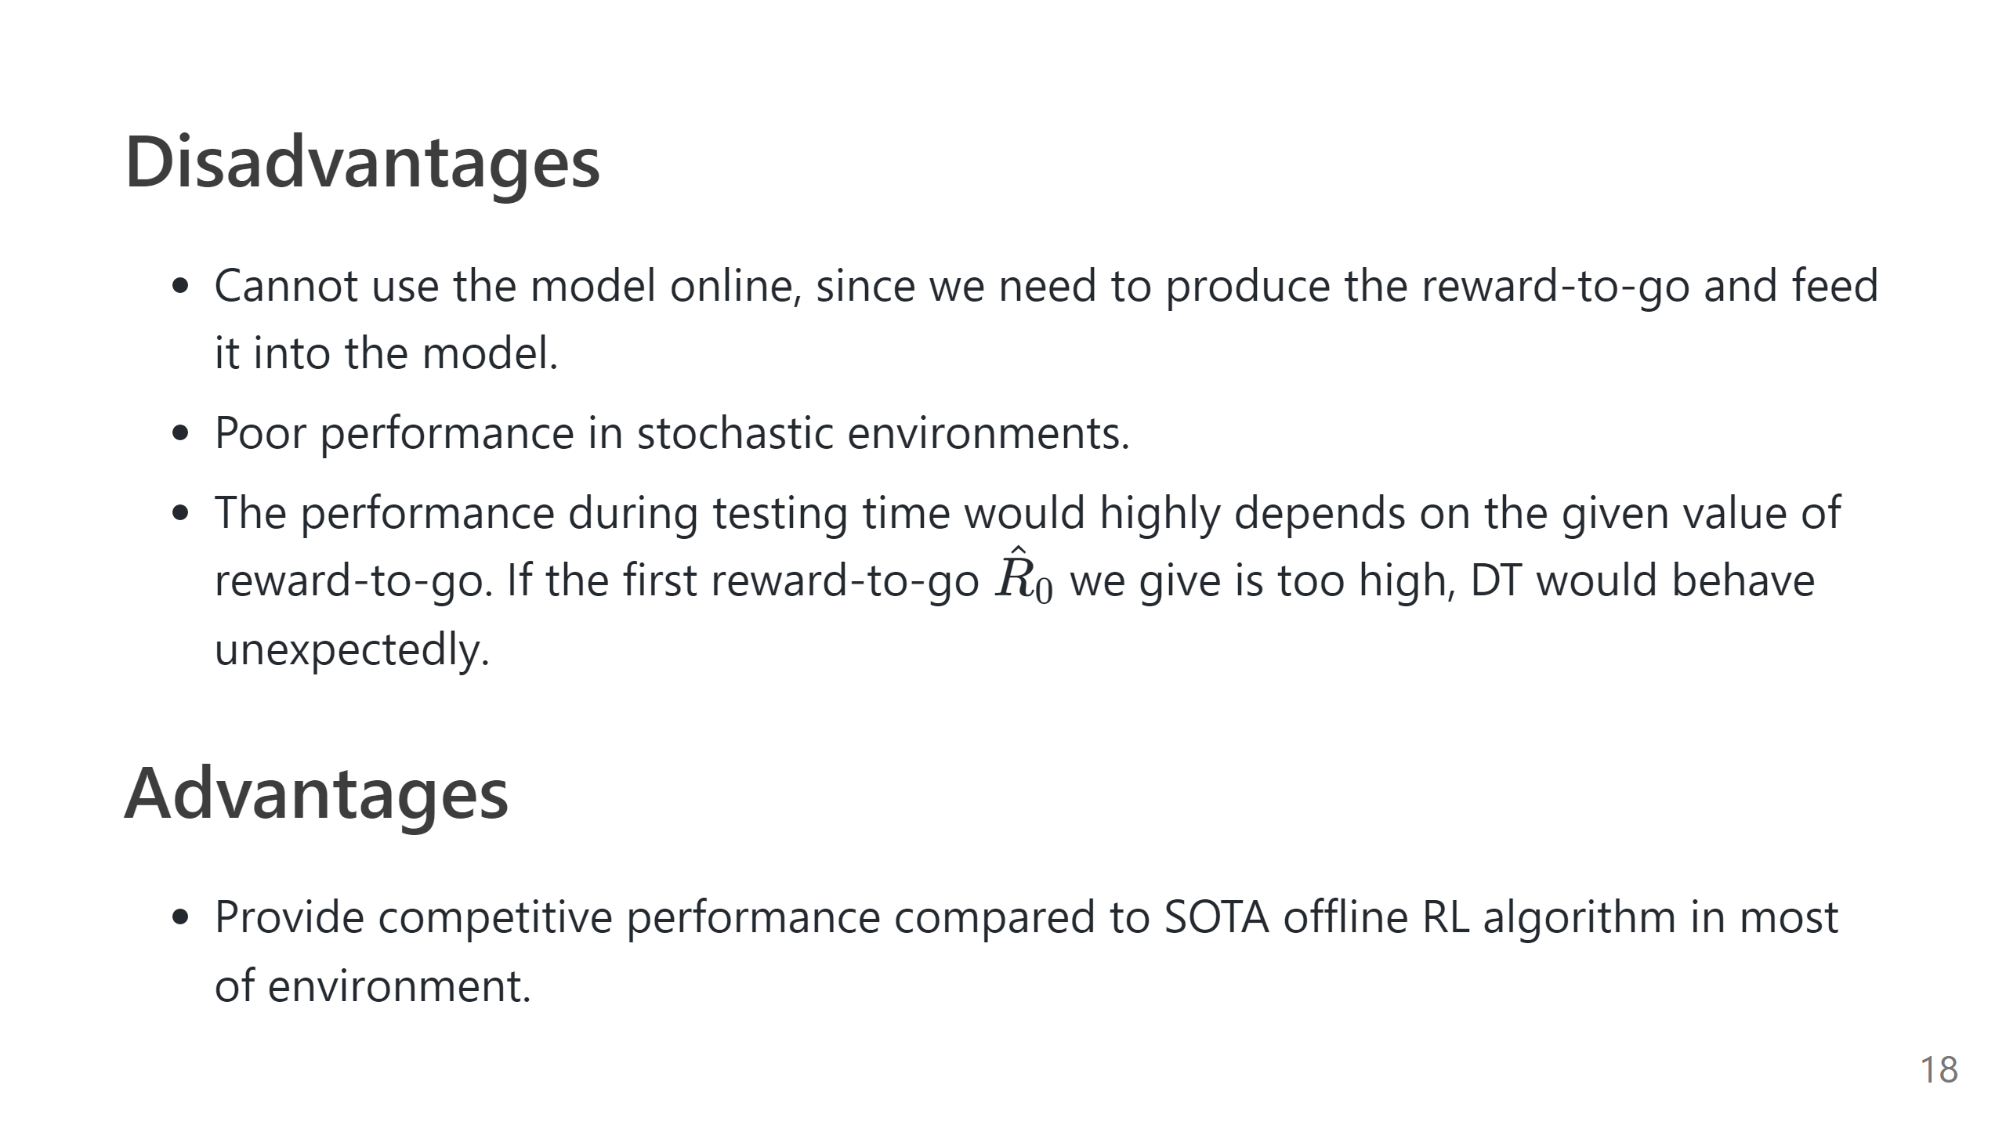

Slide 19
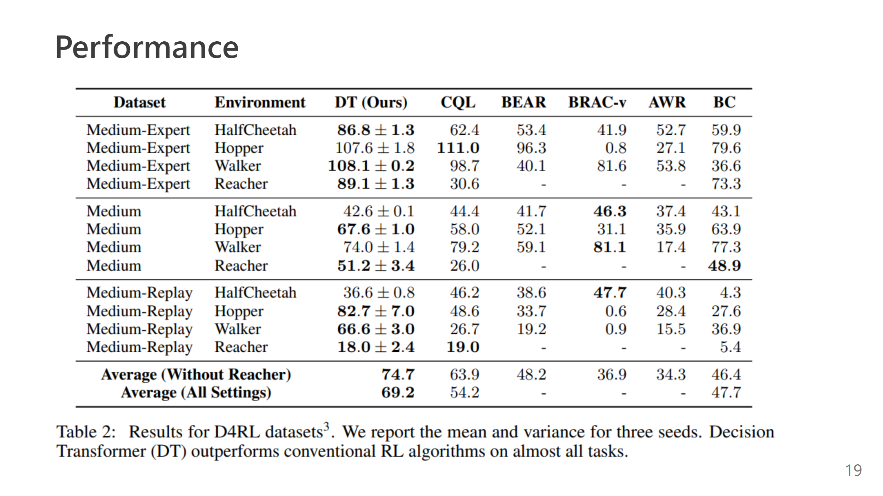

Slide 20
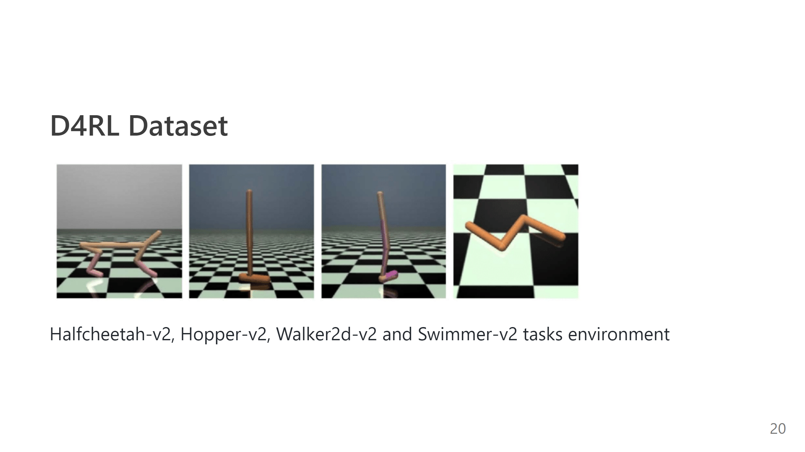

Slide 21
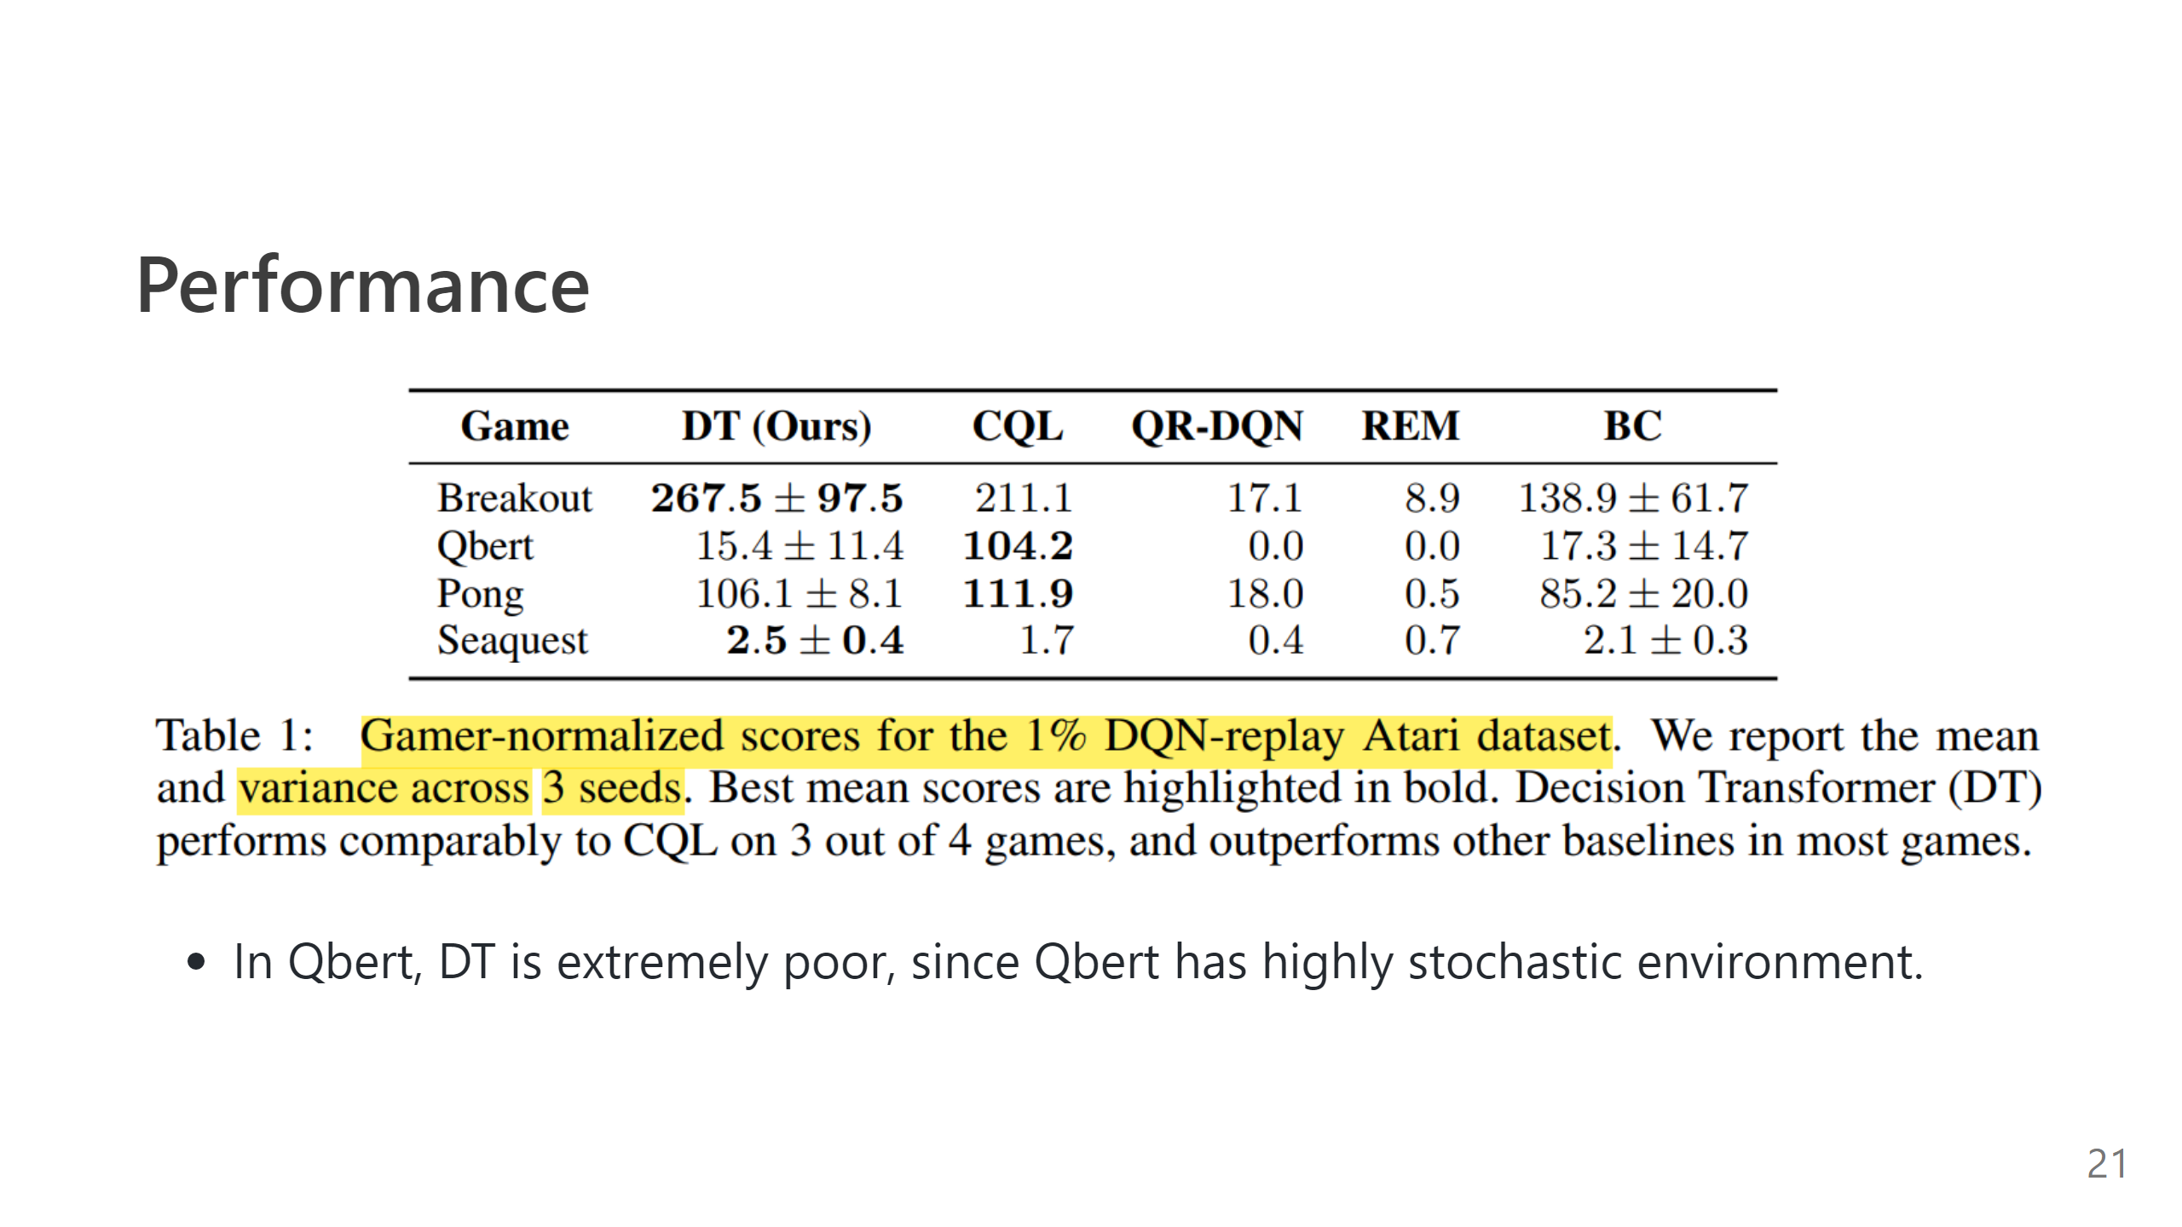

Slide 22
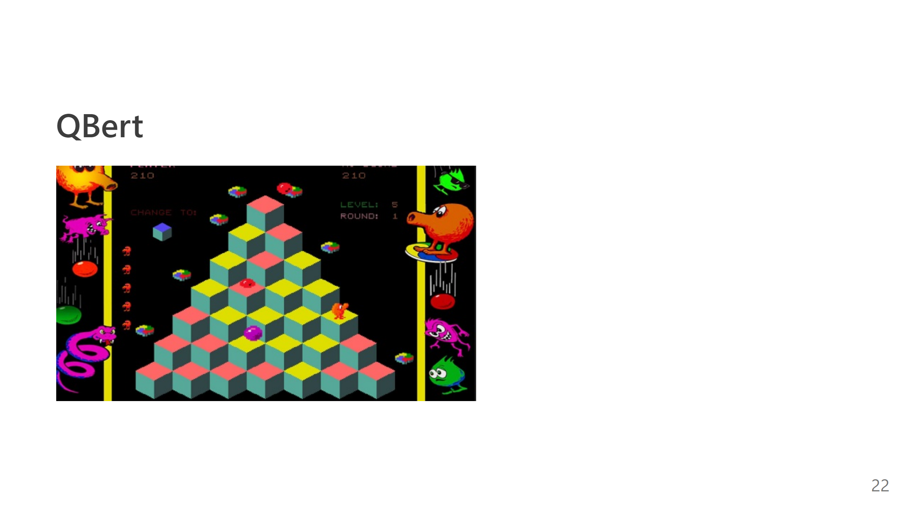

Slide 23
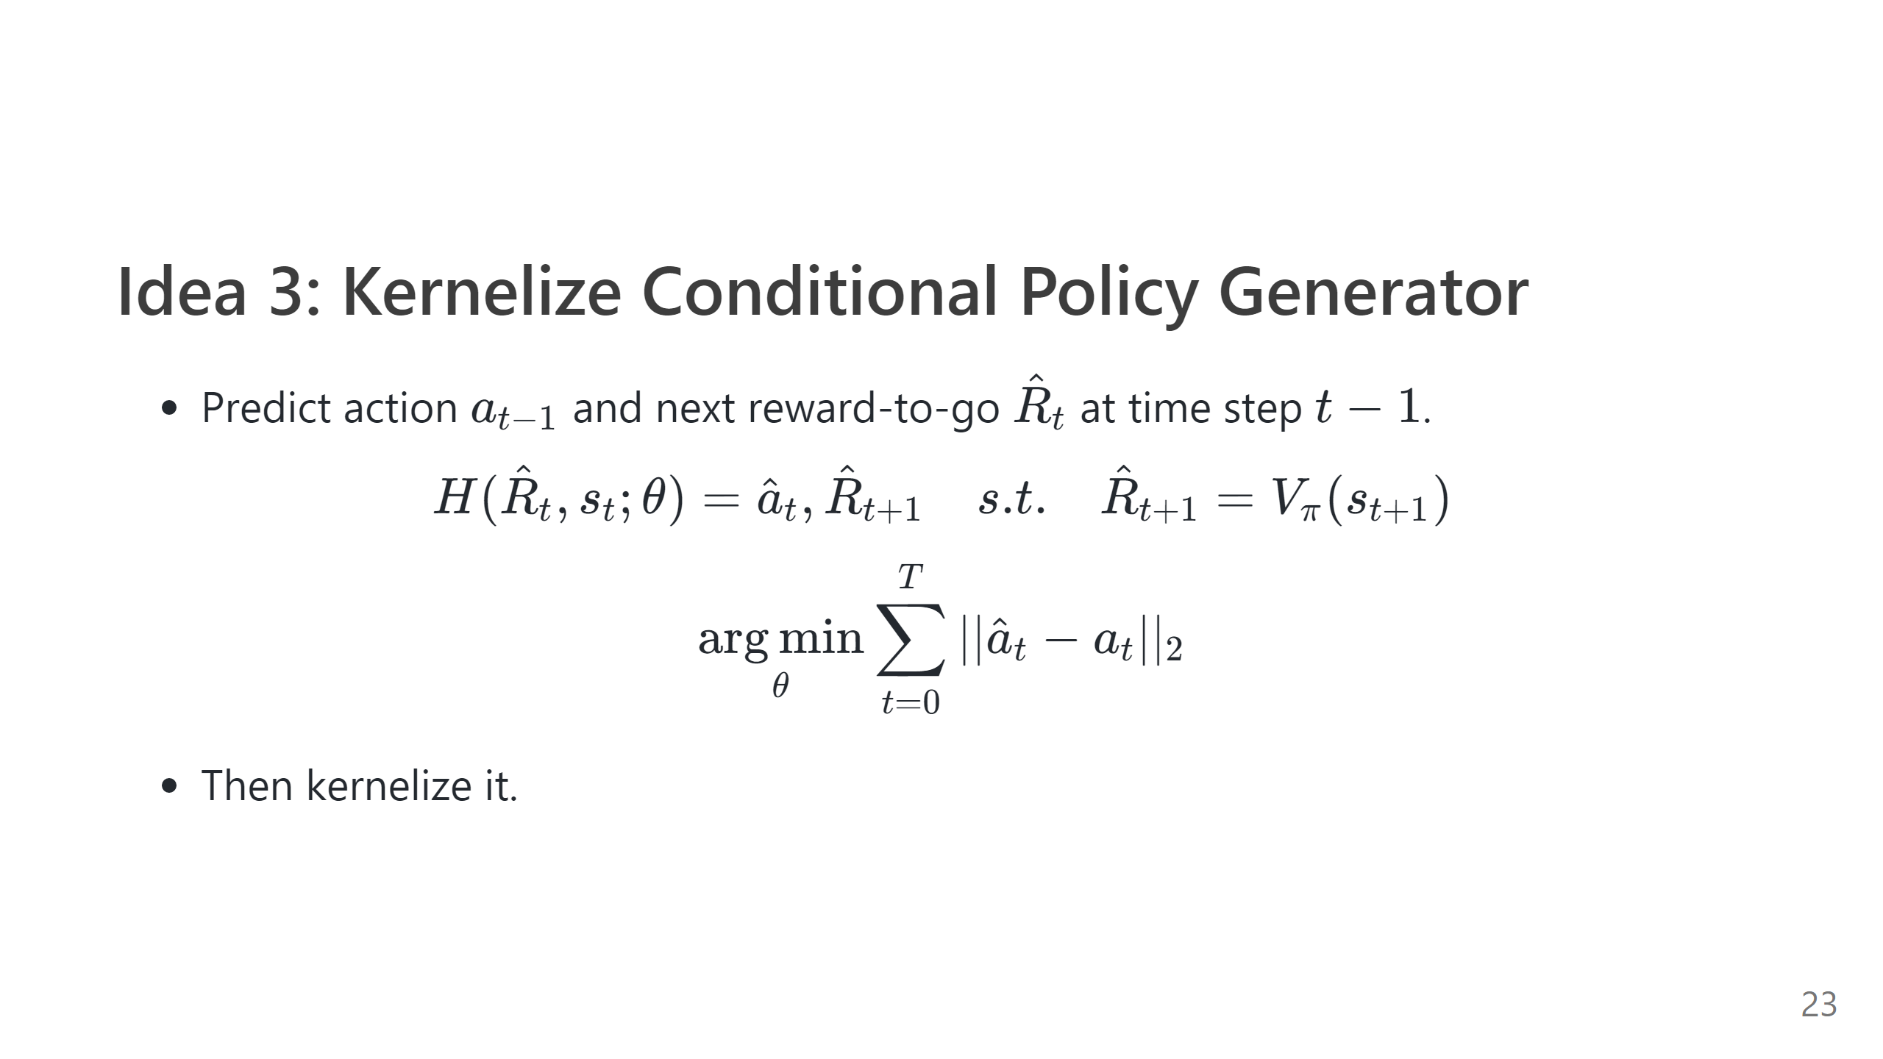

Slide 24
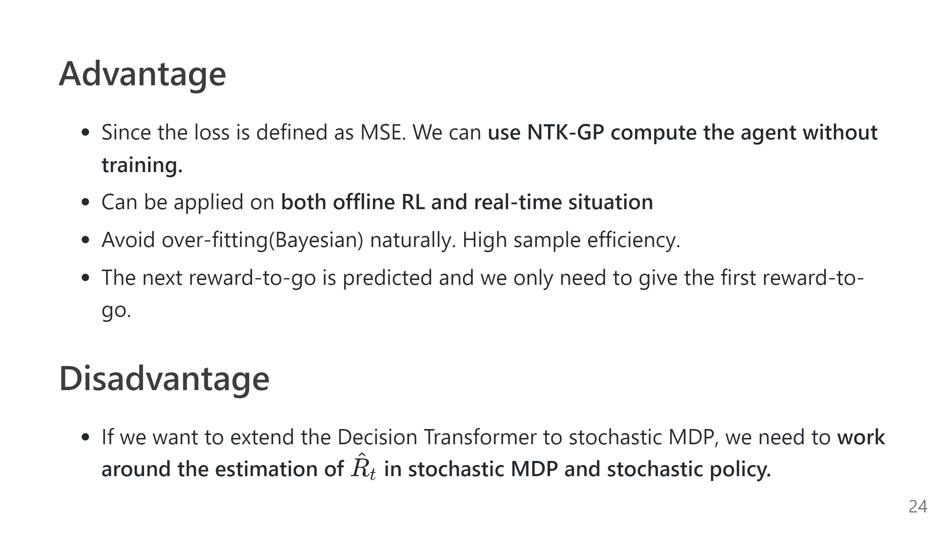

Slide 25


Slide 26
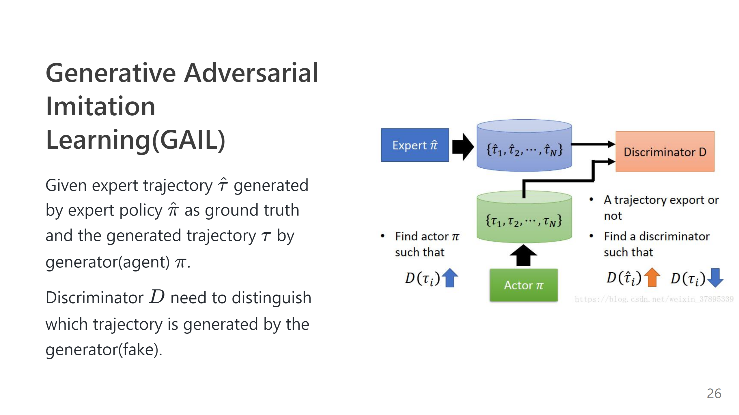

Slide 27
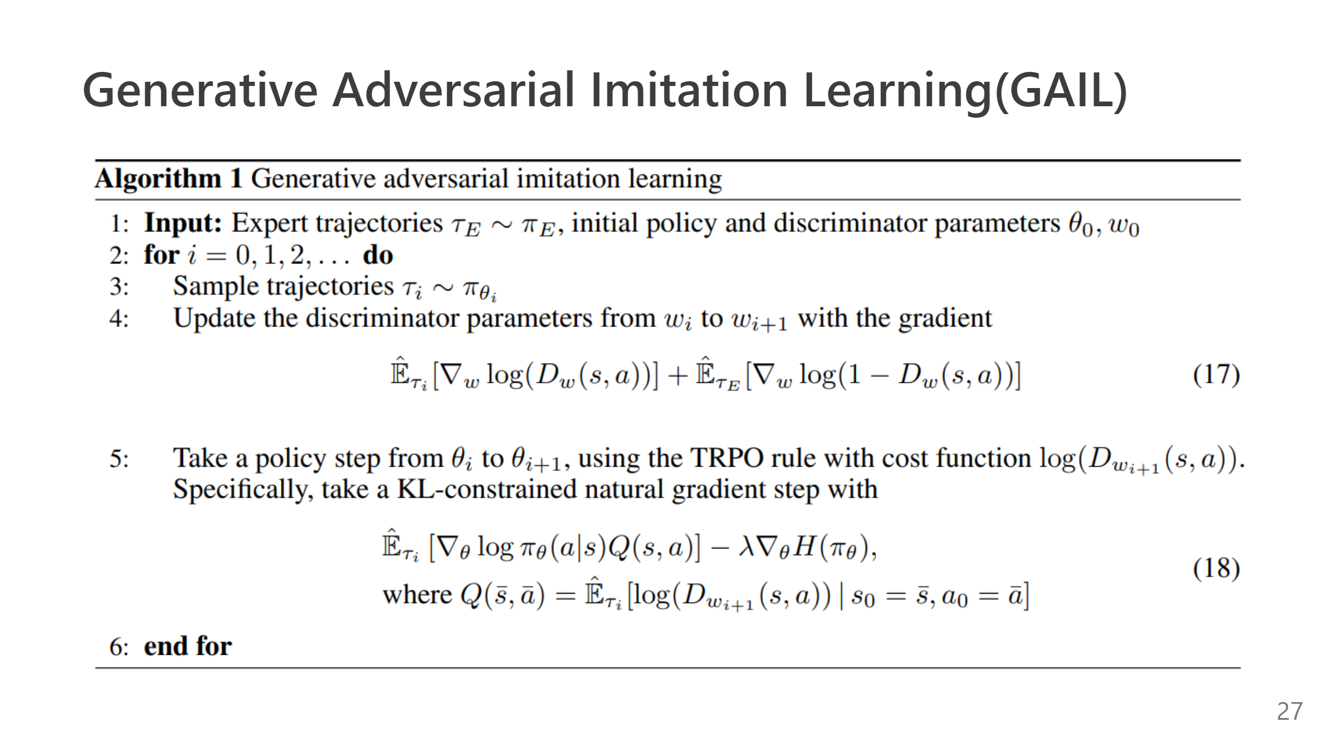

Slide 28
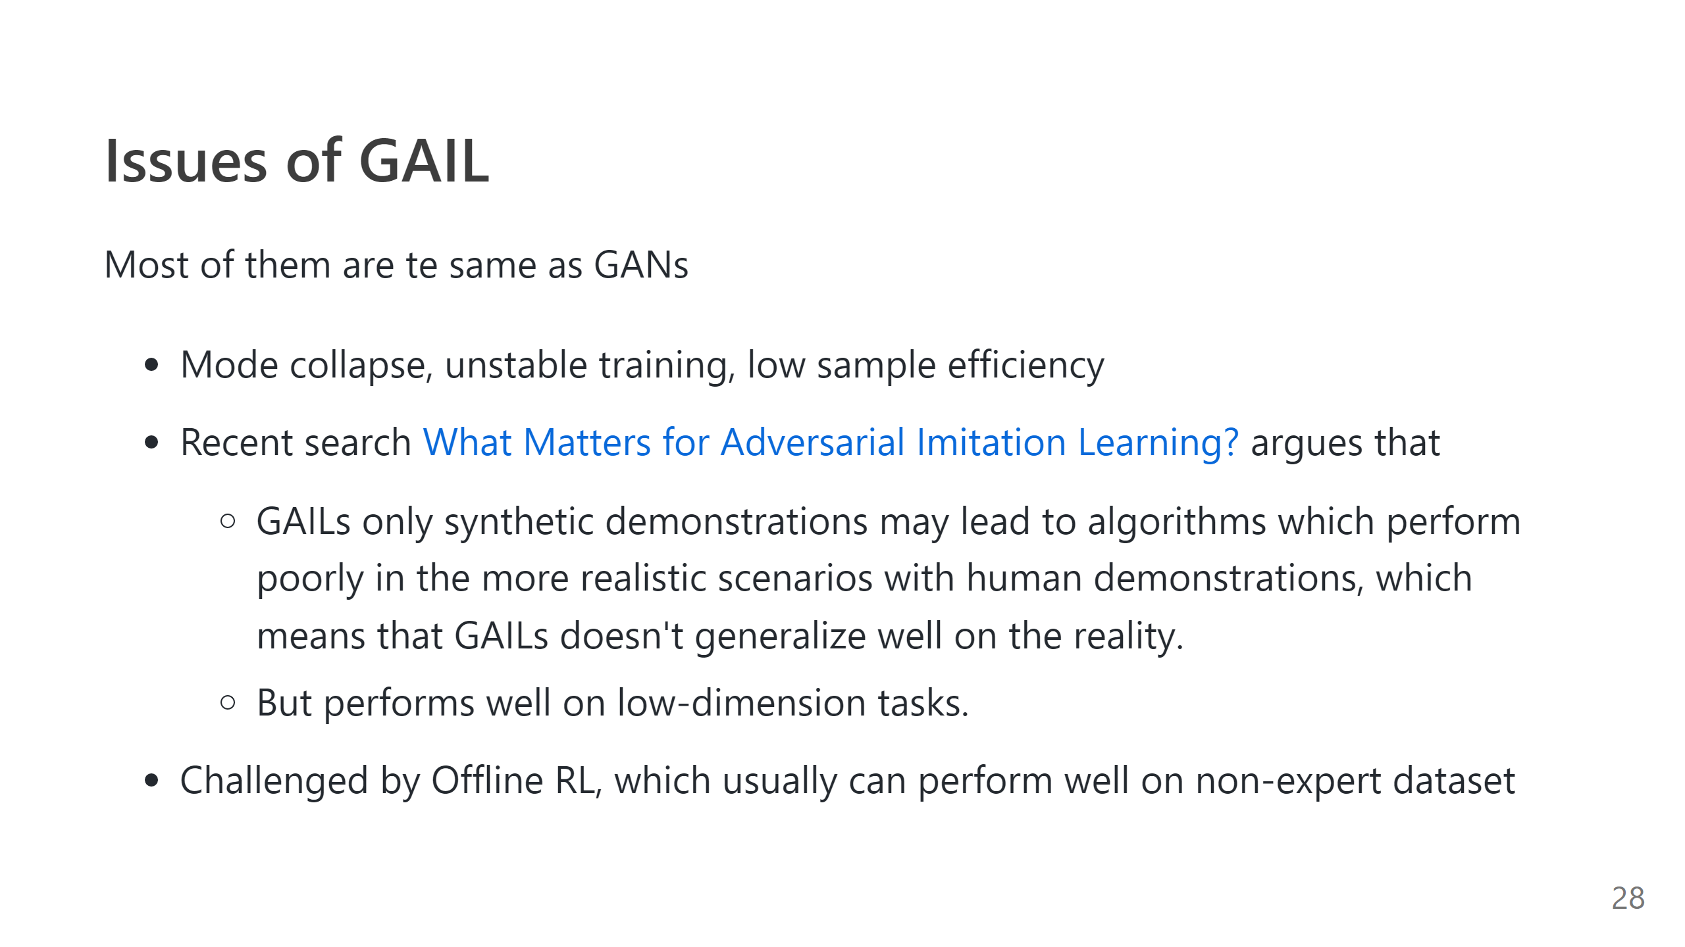

Slide 29
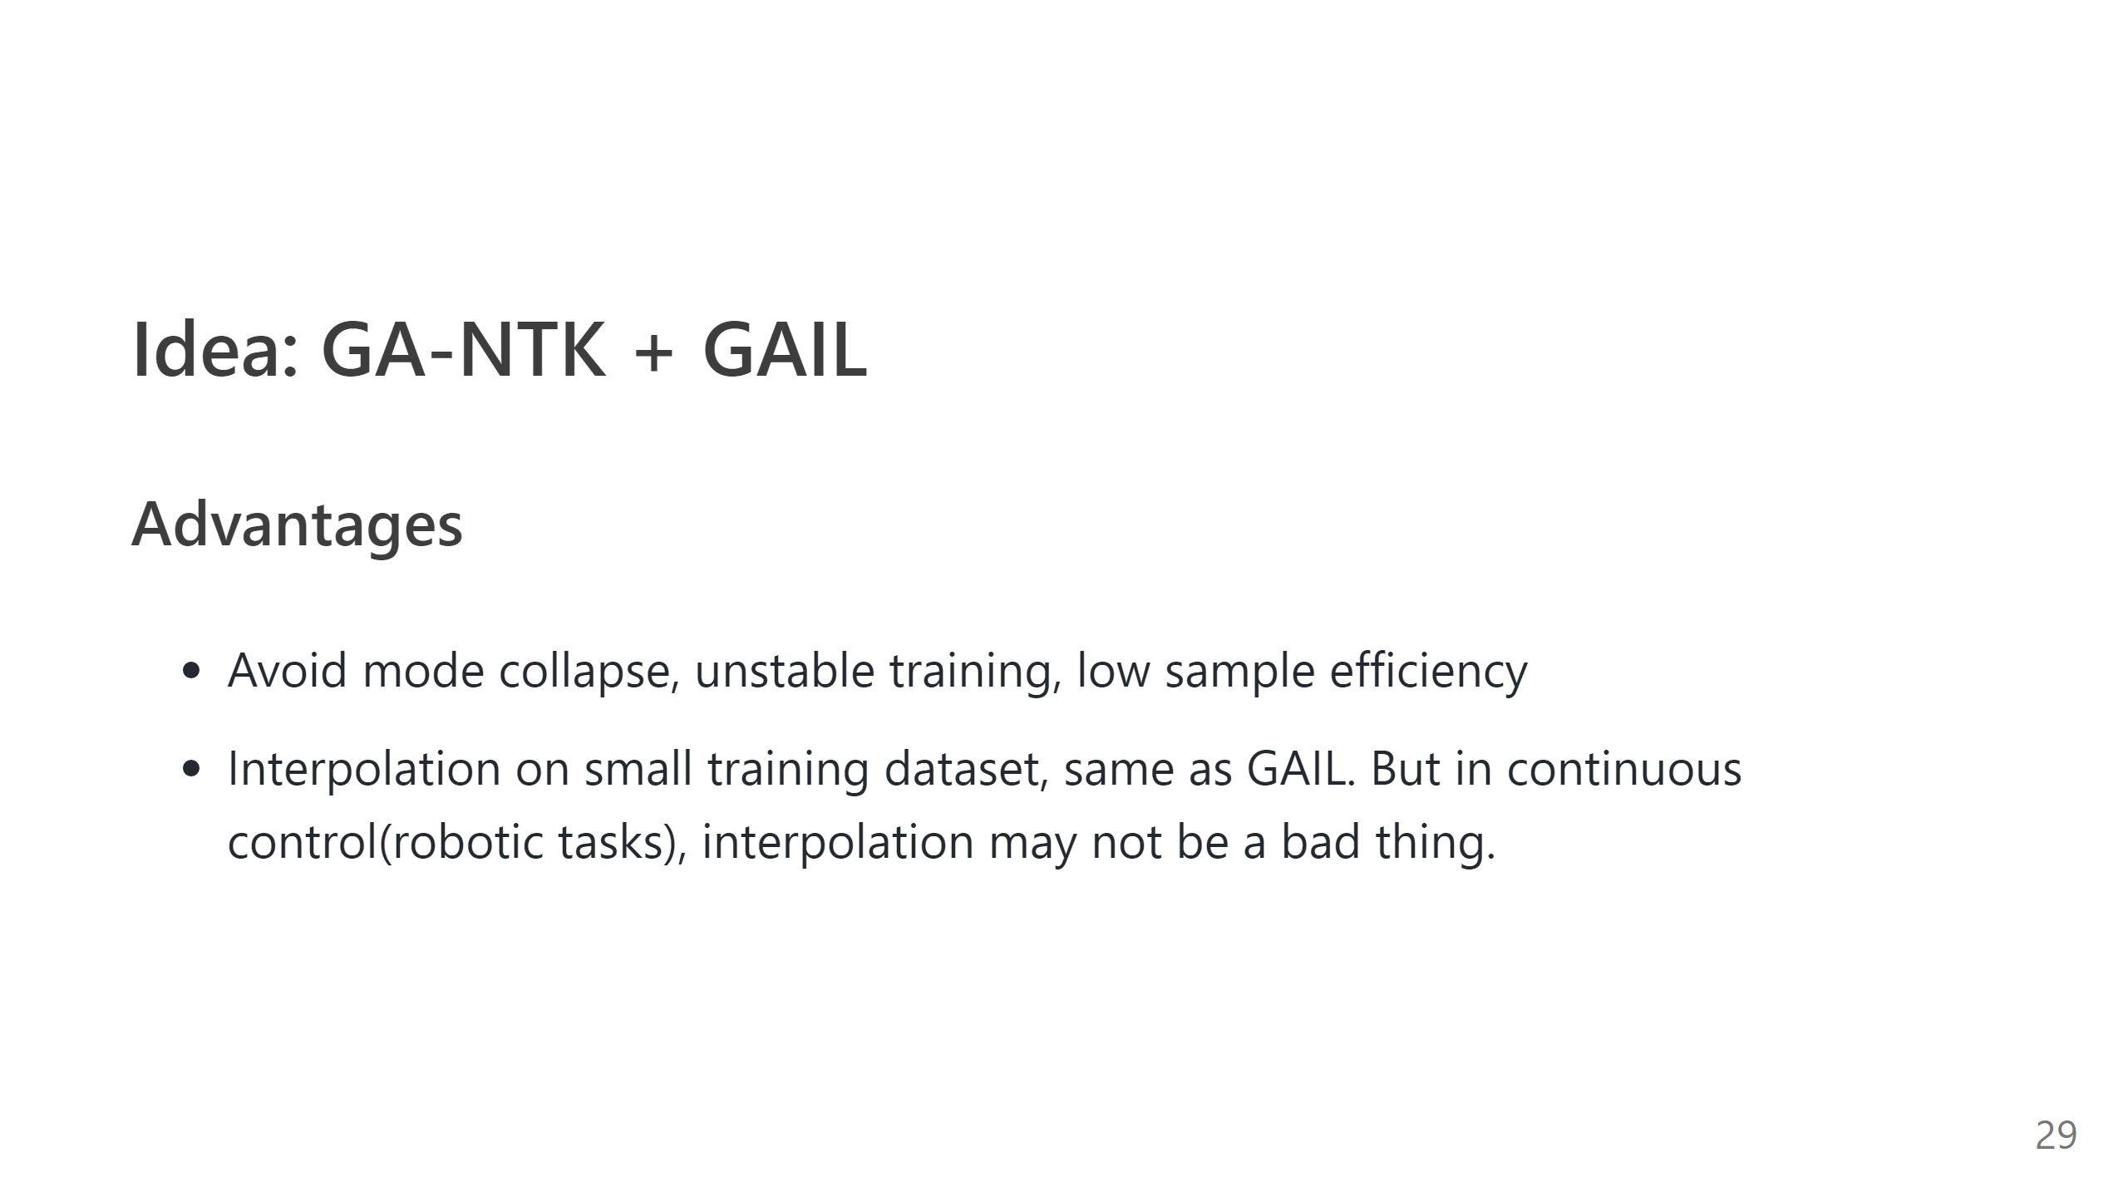

Slide 30
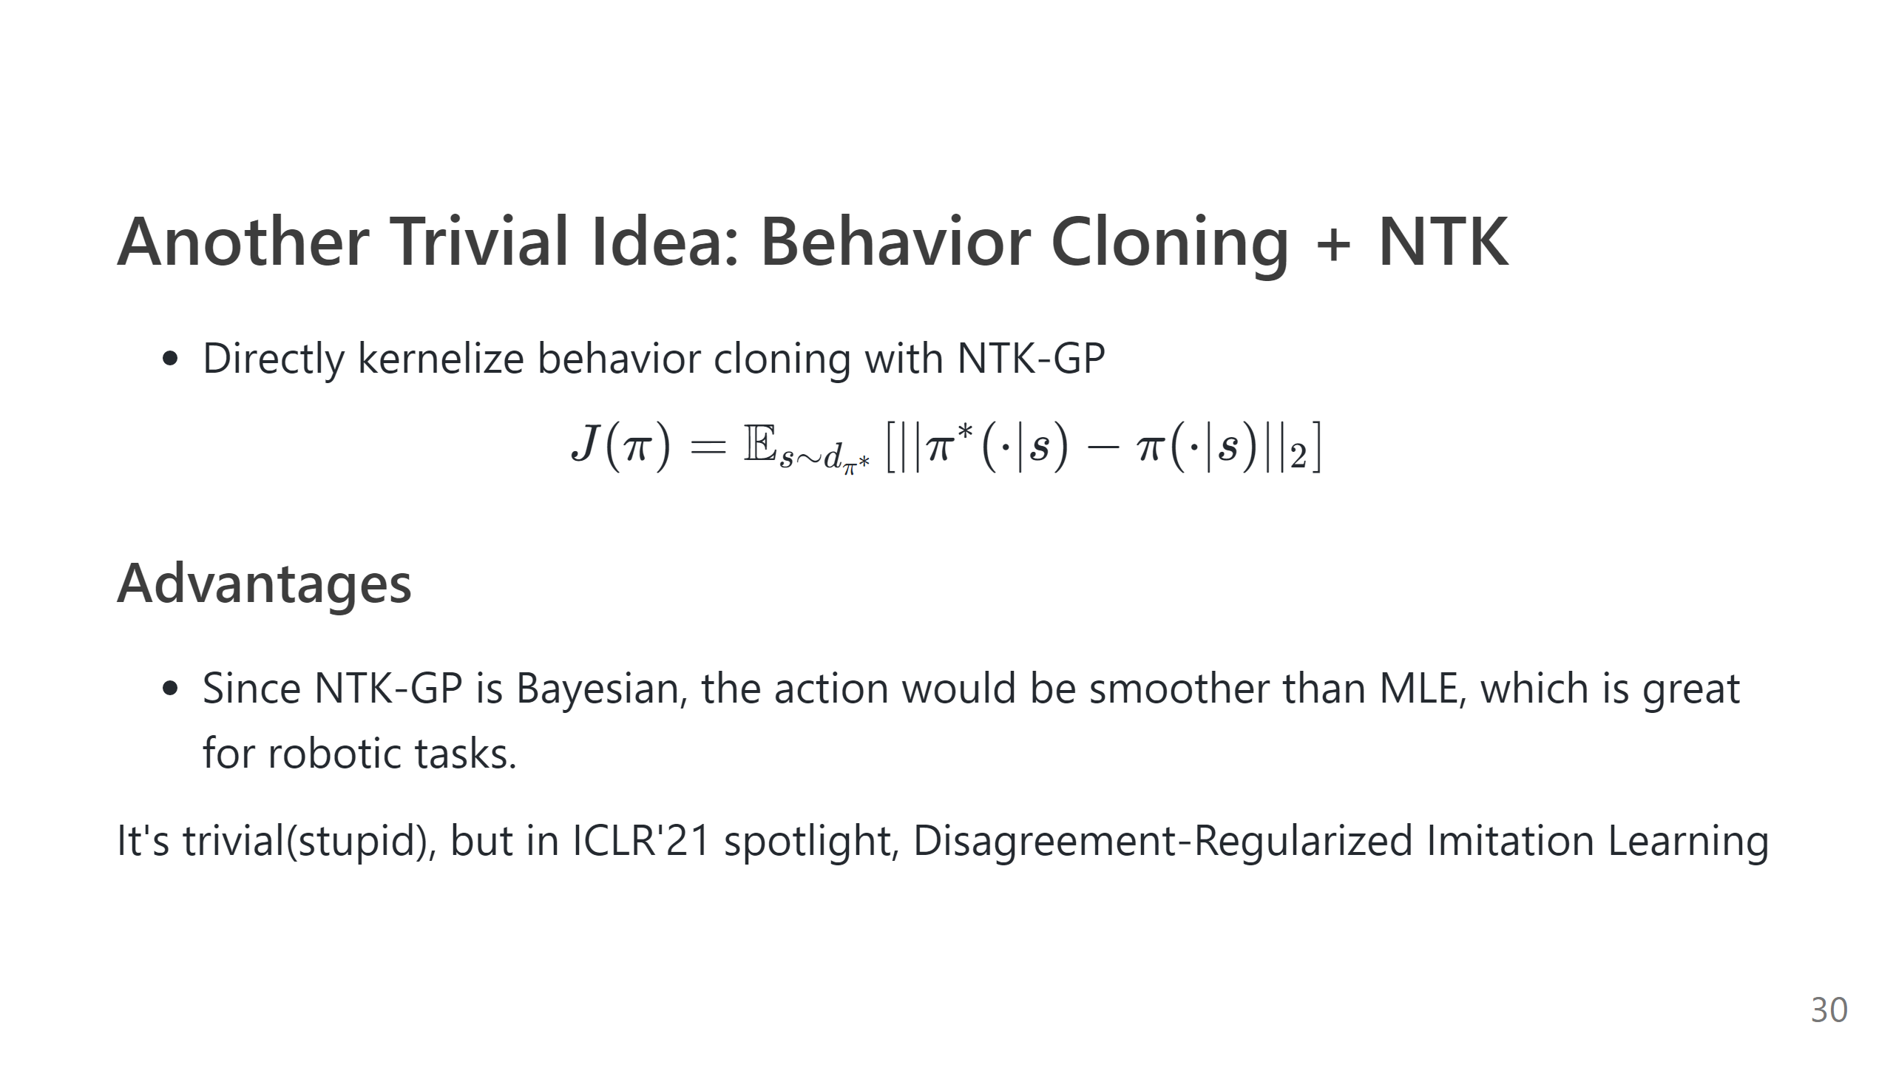

Slide 31
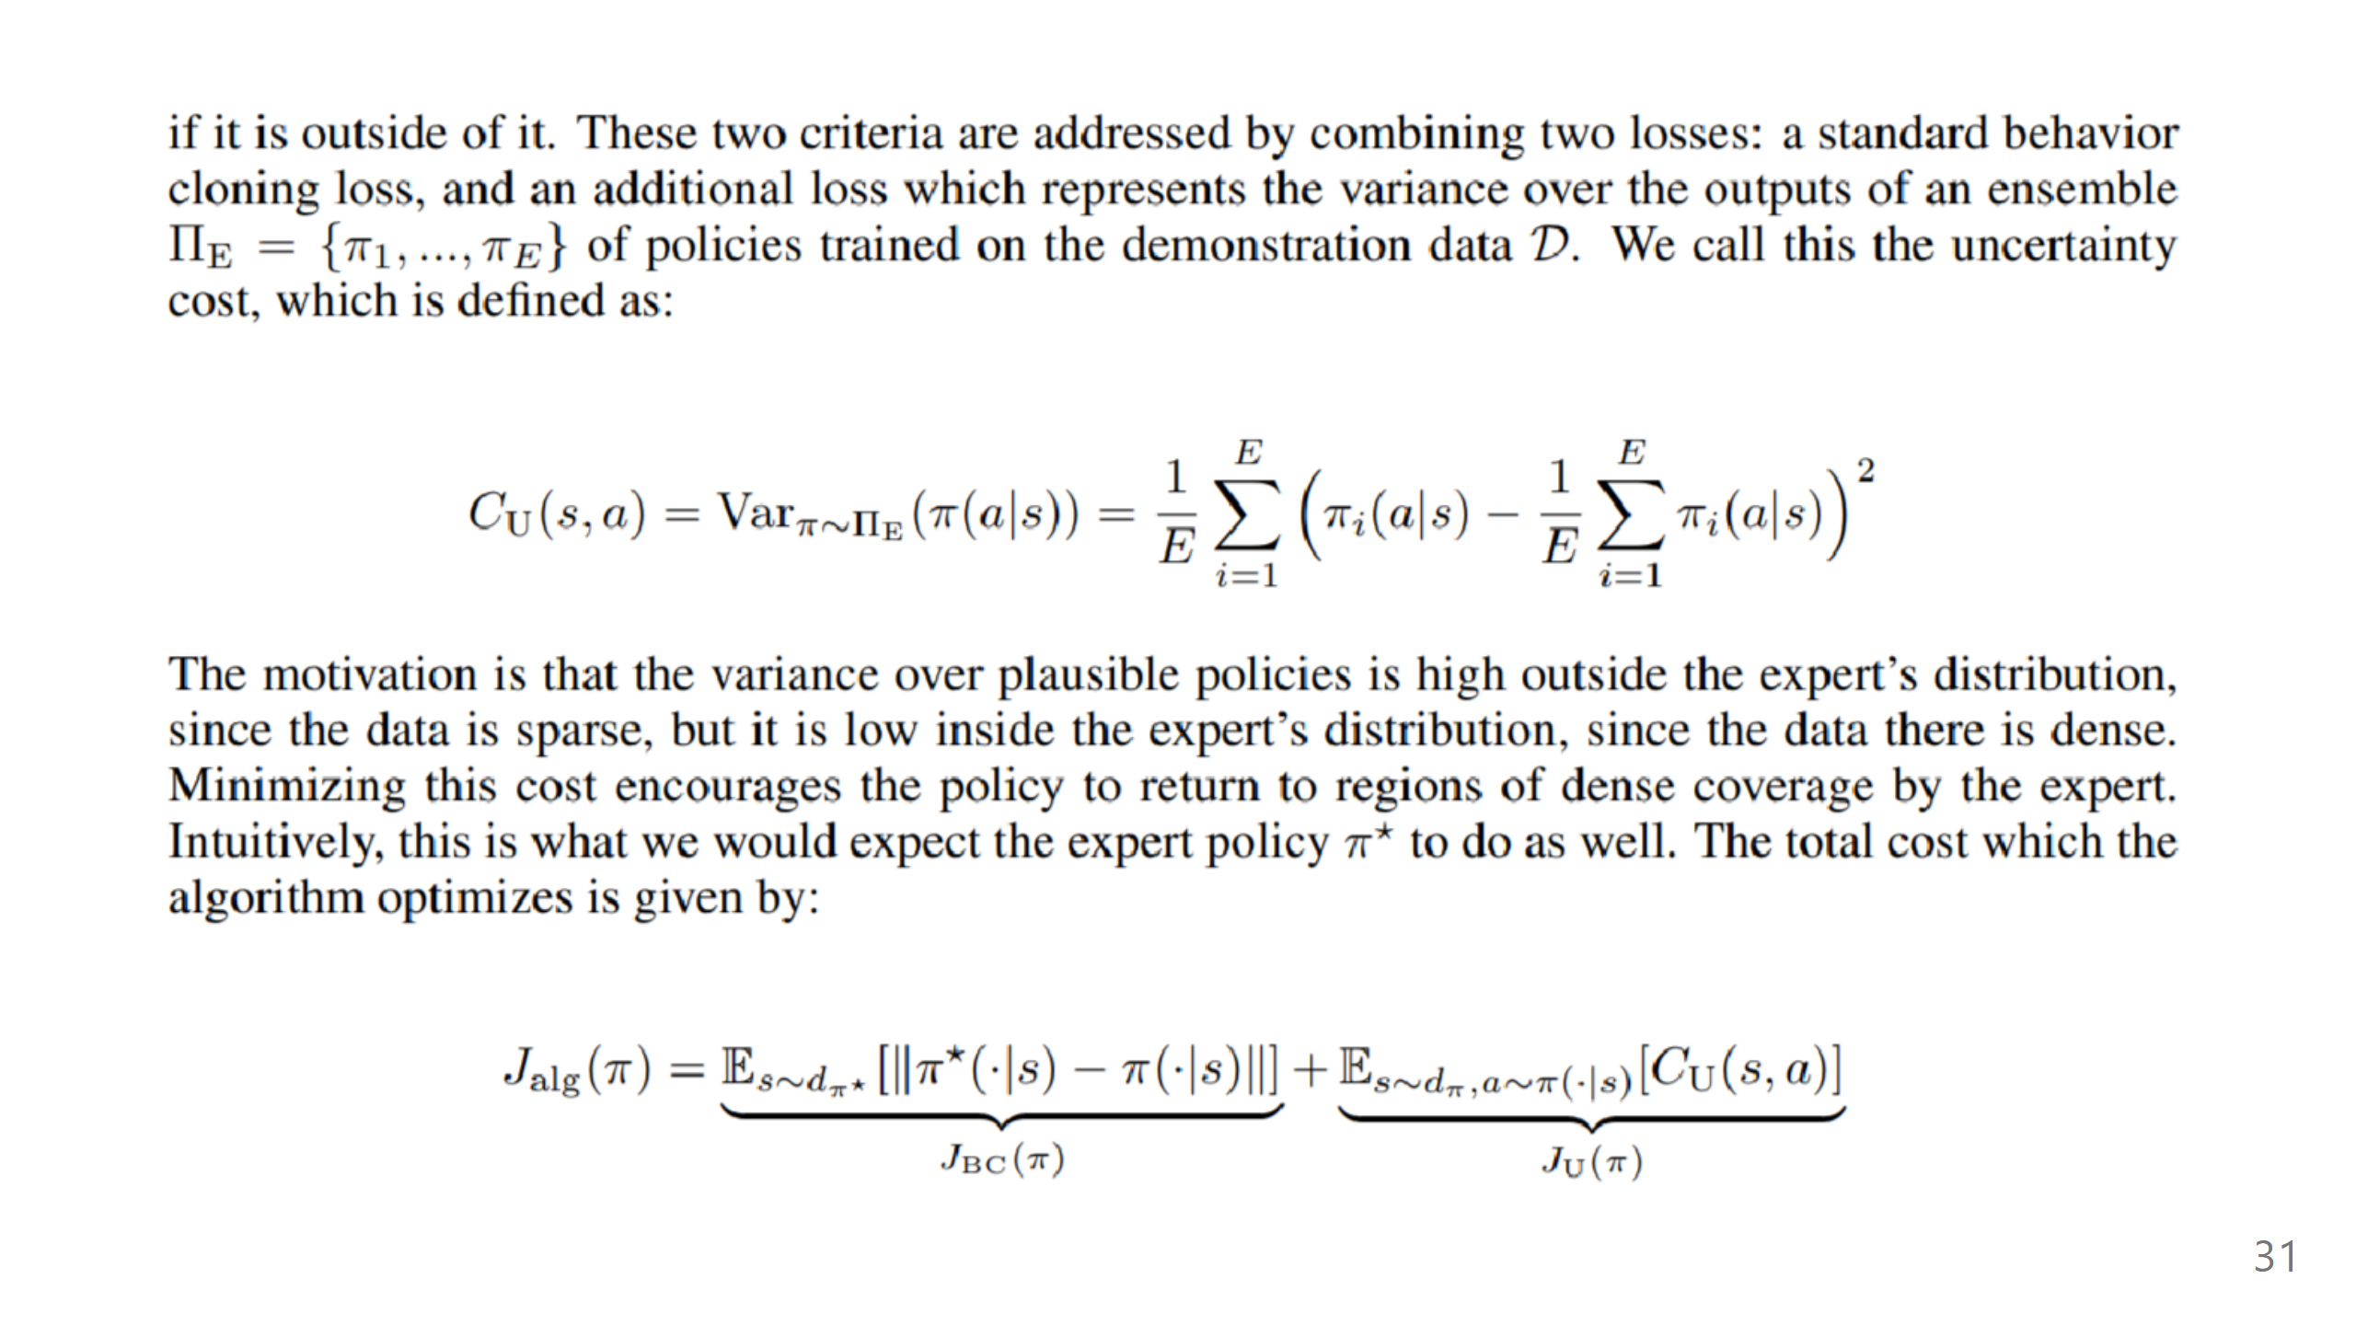

Slide 32
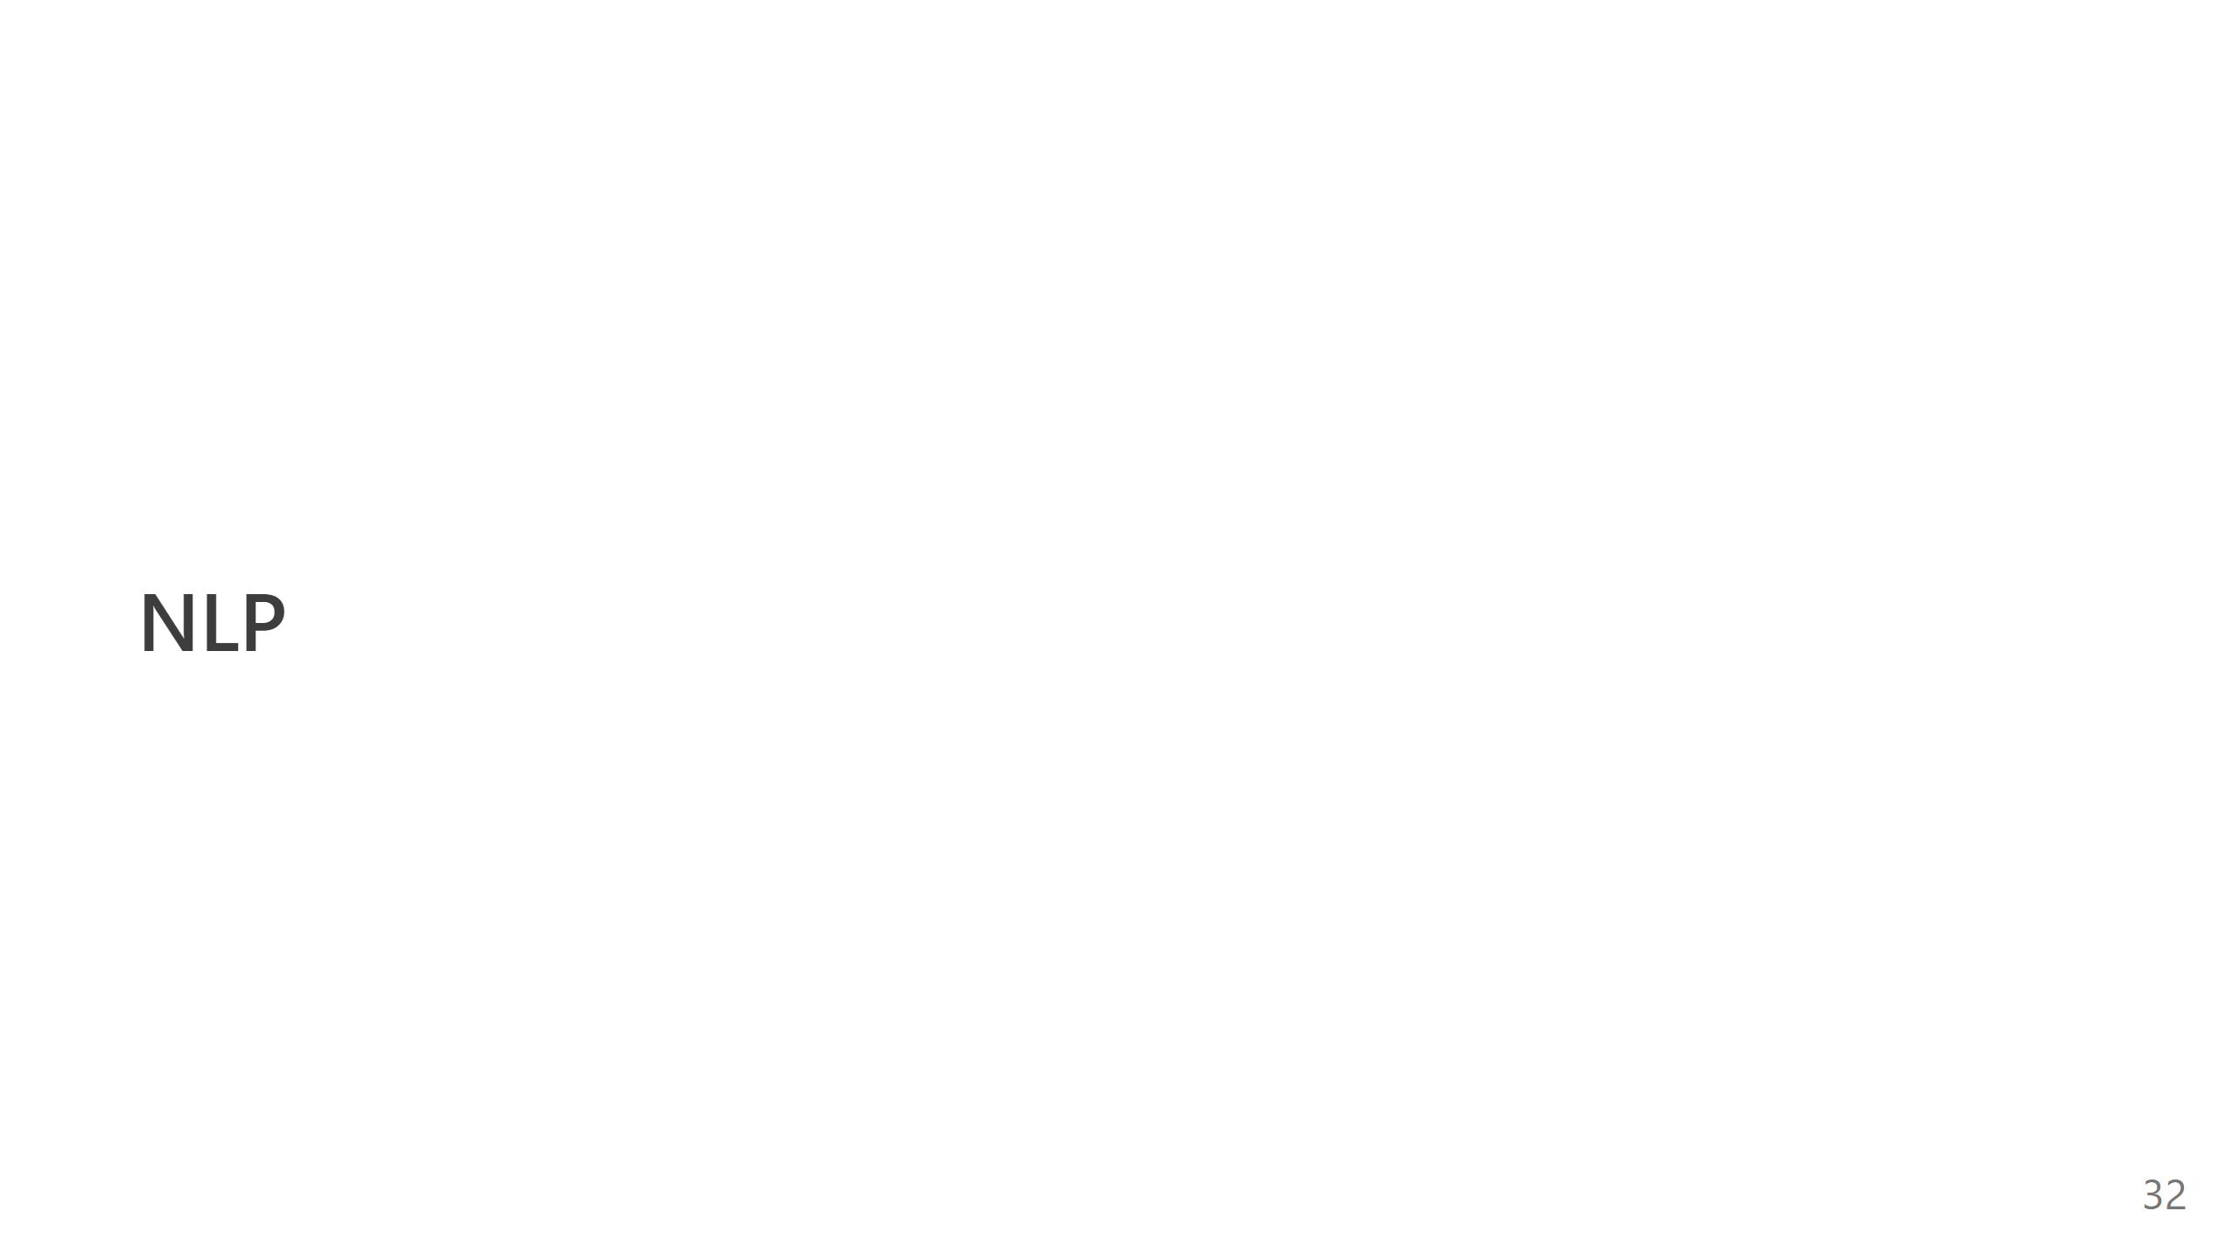

Slide 33
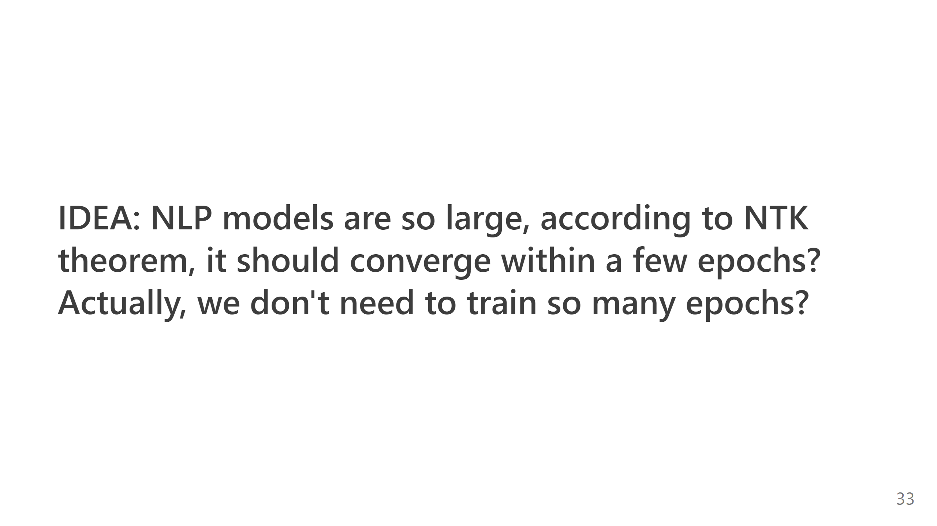
Notes:
--- Notes - Clarify MMD and support constraint - Argue more about the advantages of DT + NTK - Fix the notation of DT as sequence prediction

